Slide 1
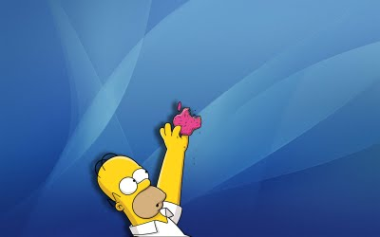
Passive voice

Slide 2
Active voice
The subject of a sentence is the person or thing we talk about.
When the subject does something, we use ACTIVE VOICE
E.g.: People sell good luck flowers.
Subject (doer)
Active verb ( it can be in diff. tenses)
Object (receiver)

Slide 3
Passive voice
It is used when the subject is not the doer of an action.
We put the receiver of an action as the subject.
We put the doer of an action as the object.
E.g.: Good luck flowers are sold by people.
Subject ( receiver)
Passive verb
(It can be in diff. tenses)
Object (Doer)

Slide 4
The form of passive voice -It is formed by: be + past participle
Active | Passive
collect
perform
decorate
light
sweep
burn
is/are collected
is/are performed
is/are decorated
is/are lit
is/are swept
is/are burnt

Slide 5
Practice
People eat moon cakes at Mid-Autumn Festival
Moon cakes are eaten (by people) at Mid-Autumn festival

Slide 6
People sweep graves with brooms at Ching Ming Festival.
Graves are swept with brooms (by people) at Ching Ming Festival.

Slide 7
People light lanterns at Mid-Autumn Festivals.
Lanterns are lit (by people) at Mid-Autumn Festivals

Slide 8
GAME TIME!

Slide 9
People sweep graves. Graves __________________.
are swept
is swept
are swept
sweep
swept

Slide 10
People buy some flowers Some flowers ______________.
are bought
is bought
bought
are bought
buyed

Slide 11
Miss Lee paints a picture. A picture ___________ by Miss Lee.
is painted
painted
are painted
paint
is painted

Slide 12
The brother make a cake. A cake ___________ by the brother.
is made
maked
is made
are made
is make

Slide 13
John buys some new clothes. Some new clothes _________ by John
are bought
bought
is bought
are bought
be bought

Slide 14
The family clean the house. The house __________________.
is cleaned by the family
is cleaned by the family
are cleaned by the family
cleaned by the family
clean by the family

Slide 15
Mr. Chan places some flowers. Some flowers __________________.
are placed by Mr. Chan
placed by Mr. Chan
is Placed by Mr. Chan
are placed by Mr. Chan
are place by Mr. Chan

Slide 16
Sally throws the old things. The old things ___________________.
are thrown by Sally
are threw by Sally
is thrown by Sally
thrown by Sally
are Thrown by Sally

Slide 17
Peter draws a car. ___________________________.
A car is drawn by Peter
A car is drew by Peter
A car is drawn by Peter
Peter is drawn by a car
Peter is drew by a car

Slide 18
Mr. and Mrs. Wu bake a cake. ___________________________.
A cake is baked by Mr. and Mrs. Wu
A cake are baked by Mr. and Mrs. Wu
A cake is baked by Mr. and Mrs. Wu
A cake baked by Mr. and Mrs. Wu
A cake bake by Mr. and Mrs. Wu.

