Slide 2
8
6
1
7
4
5
2
3

Slide 4
confidence
trembles
hadn’t
socialize
sympathy

Slide 5
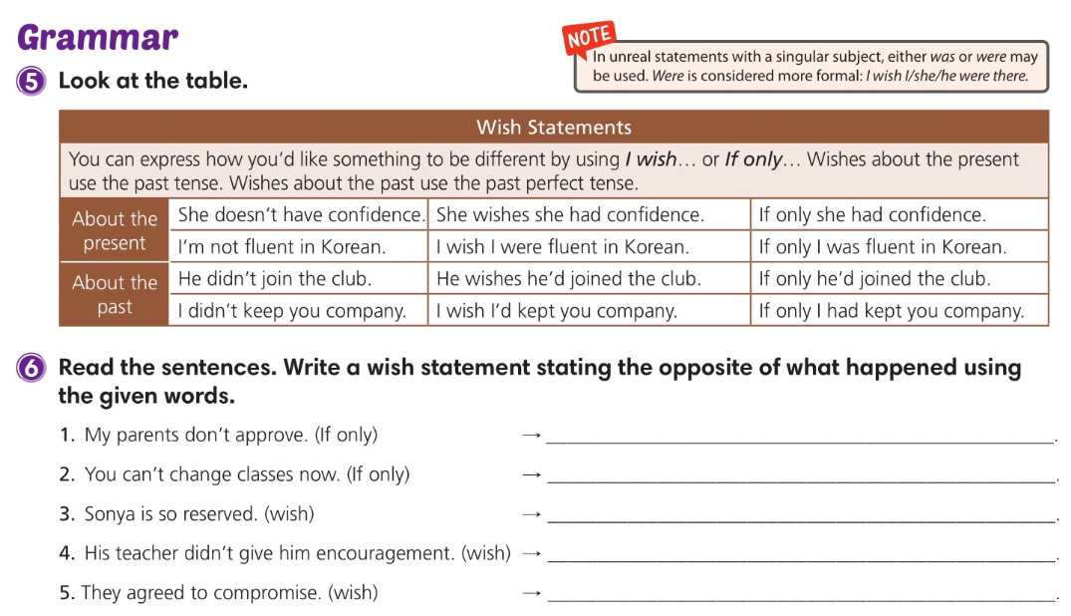
If only my parents approved
If only you could change classes now
I wish Sonya weren’t / wasn’t so reserved
I wish his teacher had given him encouragement
I wish they hadn’t agreed to compromise

Slide 6
I could remember the homework assignment.
I had more money to buy these shoes.
I had gone to summer camp last year.
I hadn’t lost my dog in the park last month.

Slide 8
earnings
skilled
mess up
blame
temptation
deal with
constantly
distract

Slide 9
skilled
temptation
earnings
mess up
constantly
distracting
blame
deal with

Slide 11
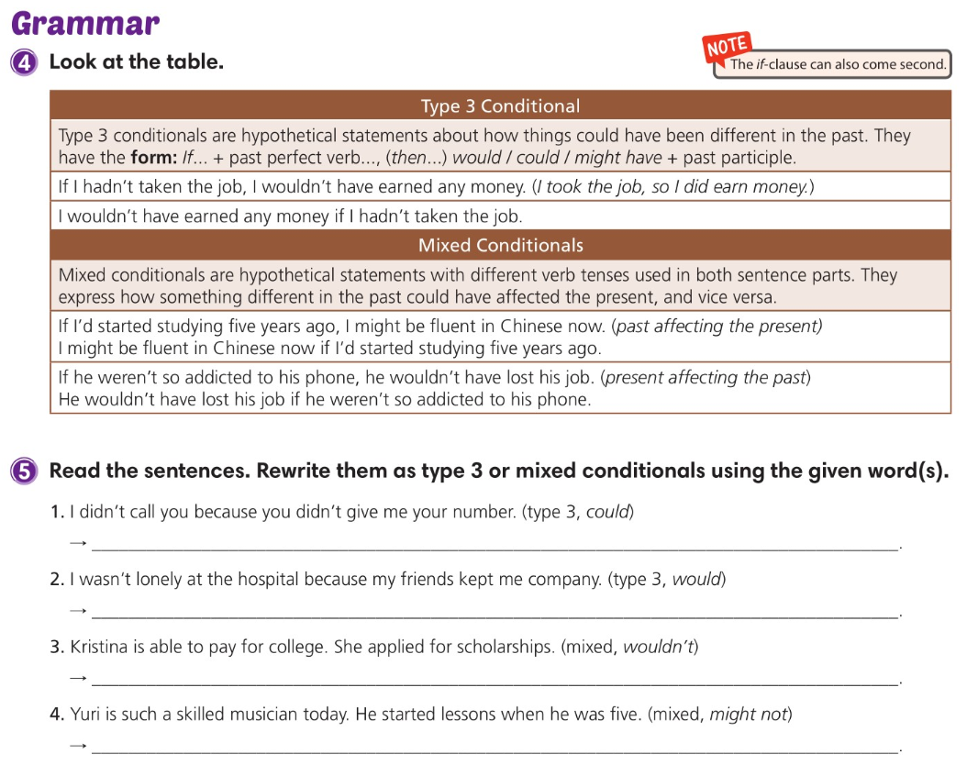

Slide 12
I could have called you if you’d given me your number.
If my friends hadn’t kept me company, I would have been lonely at the hospital.
If she hadn’t applied for scholarships, Kristina wouldn’t be able to pay for college.
If he hadn’t started lessons when he was five, Yuri might not be such a skilled musician today.

Slide 14
7
6
3
4
8
2
1
5

Slide 15
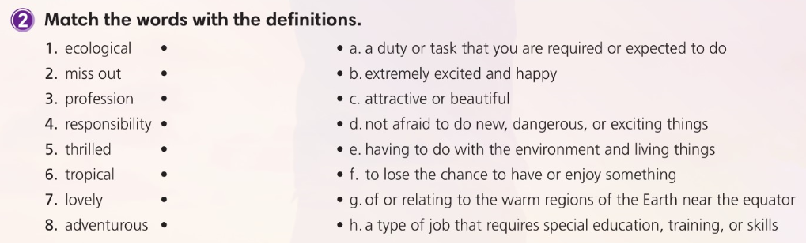

Slide 17
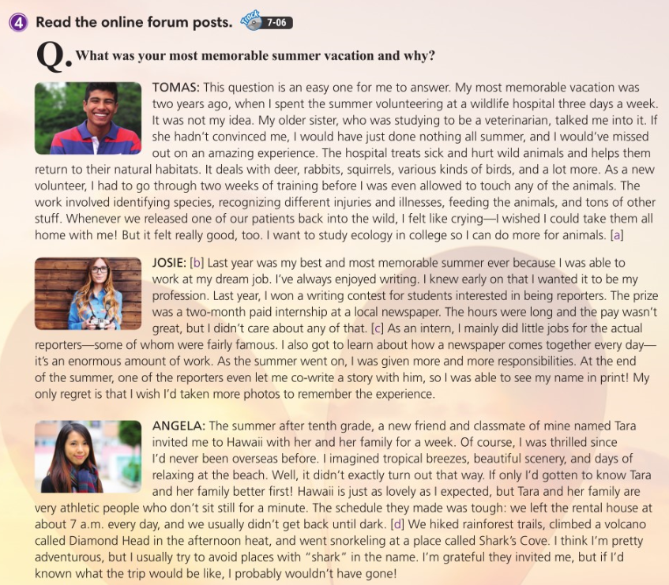

Slide 19
7
5
6
8
3
2
1
4

Slide 20
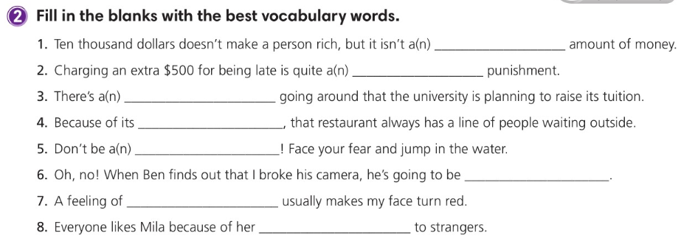
trivial
severe
rumor
popularity
coward
furious
embarrassment
friendliness

Slide 22
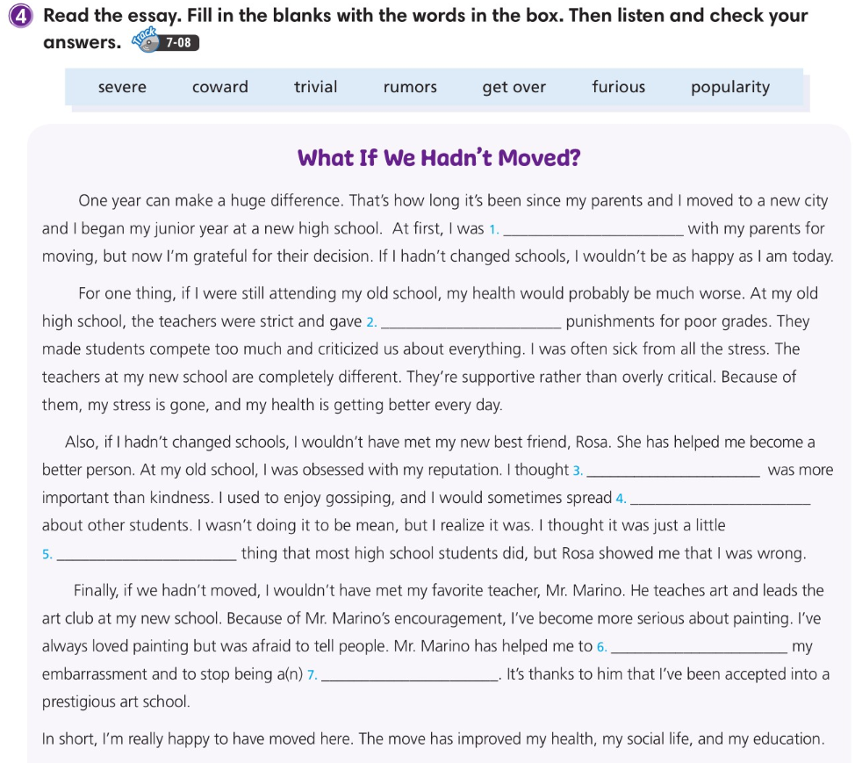
furious
severe
popularity
rumors
trivial
get over
coward

Slide 23
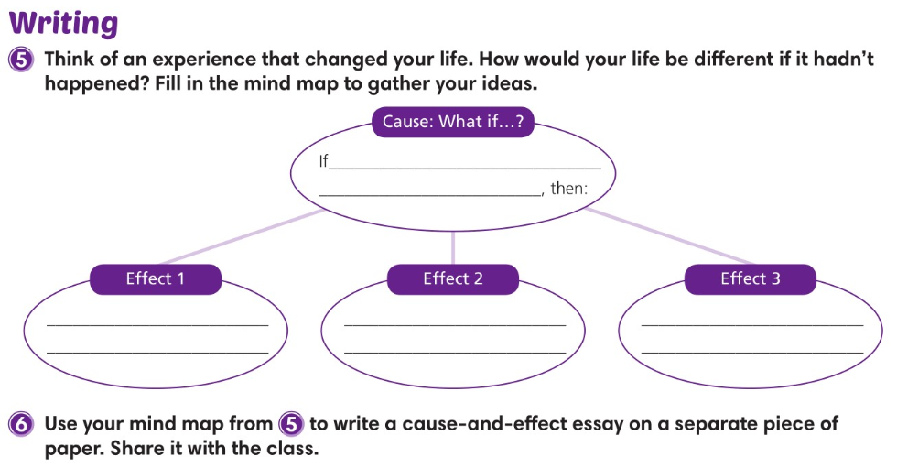

Slide 24
2
3
1

Slide 25
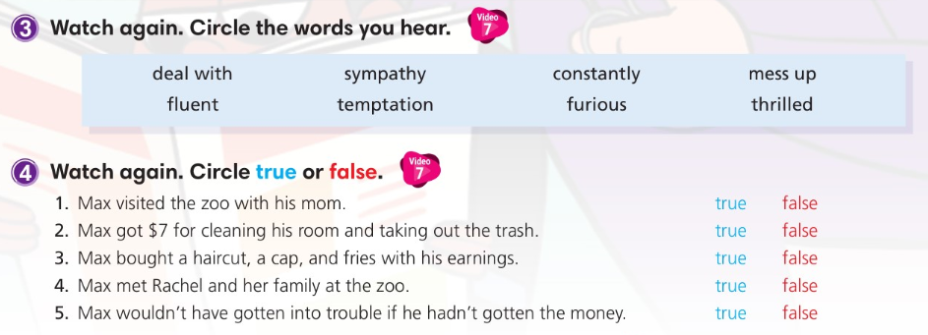

Slide 26
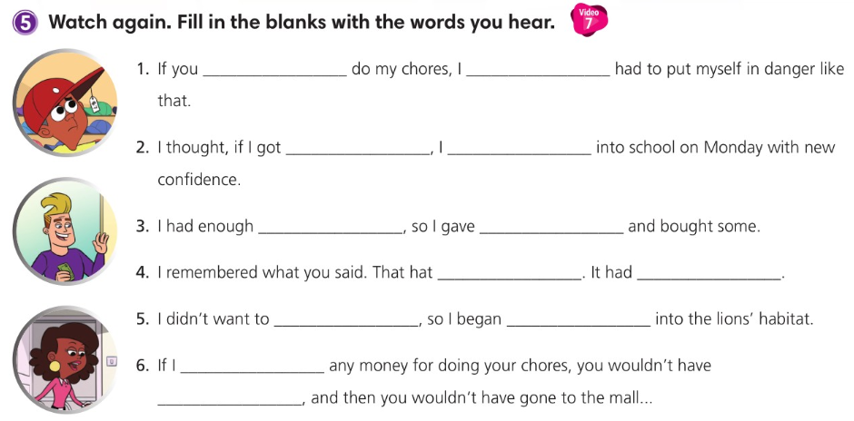
hadn't made me
wouldn't have
a new haircut
could walk
money left over
into temptation
was my
responsibility
cost me $7
be a coward
to climb down
hadn't given you
gotten a haircut

