Slide 2
4
1
7
6
5
8
3
2
72

Slide 3
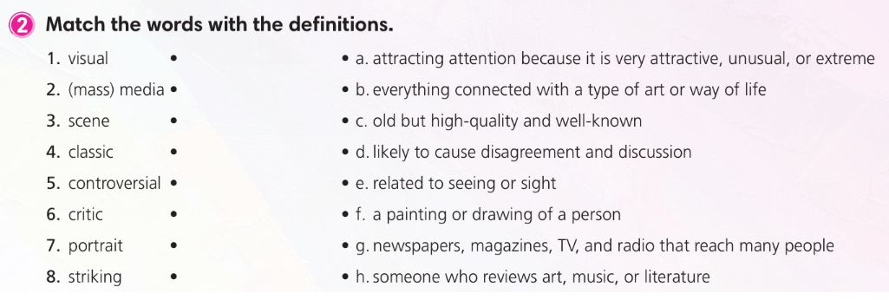

Slide 4
3
7
2
1
4
5
6
8
76

Slide 5
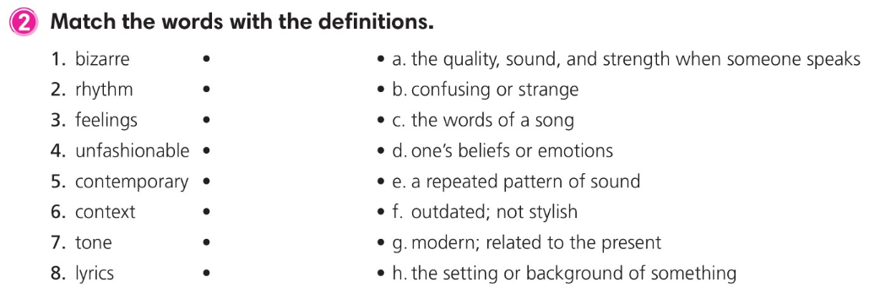

Slide 6
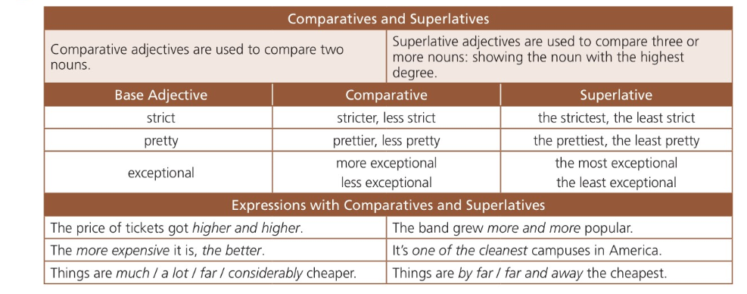
Comparative adjectives: เปรียบเทียบความแตกต่างระหว่าง 2 สิ่งว่าเป็นอย่างไร
Superlative adjectives: เปรียบเทียบที่แสดงให้เห็นความมากกว่า น้อยกว่า ของ 3 สิ่งขึ้นไป
Adj. | Comparative | Superlative
มีพยางค์เดียว | big → bigger, tall → taller | the close → closest, happy → happiest
มี 2 พยางค์ | happy → happier, easy → easier | the happy → happiest, simple → simplest
มีมากกว่า2 พยางค์ขึ้นไป | beautiful → more beautiful than important → more important than | the most beautiful the most important

Slide 7
Active: Picasso painted The Weeping Woman in 1937.
subject
verb
object
Passive: The Weeping Woman was painted (by Picasso) in 1937.
agent
Past Simple Passive: was/were + past participle

Slide 8
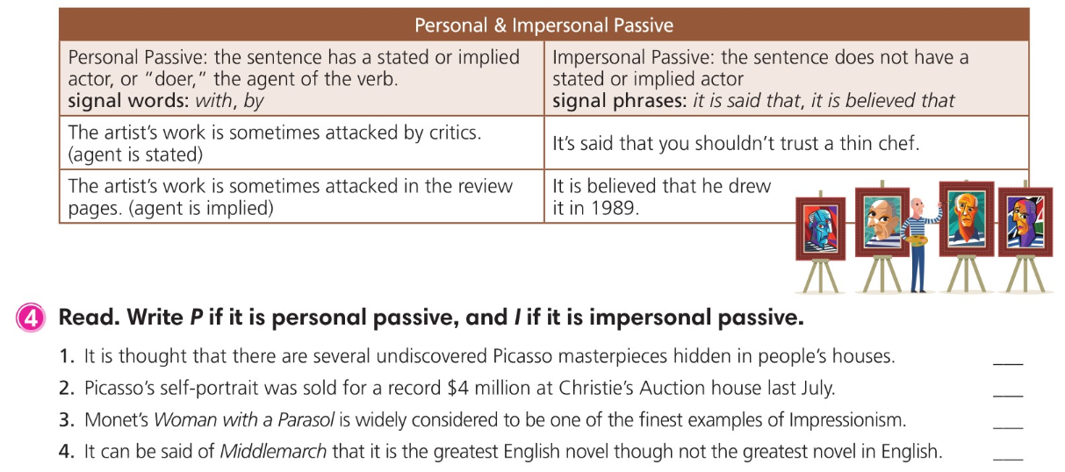
I
P
P
I

Slide 9
Active: My mother bought that car.
subject
verb
object
Passive: That car was bought (by mother).
agent
Past Simple Passive: was/were + past participle
Active: Picasso painted The Weeping Woman in 1937.
subject
verb
object
Passive: The Weeping Woman was painted (by Picasso) in 1937.
agent
Past Simple Passive: was/were + past participle

Slide 10
This year’s Nobel Prize in literature was won by a Spanish novelist.
The other team could have been beaten.
The project might be finished before tomorrow’s deadline.
The script should have been written by Jay Reid.

Slide 11
2
4
1
3
8
7
5
6

Slide 12
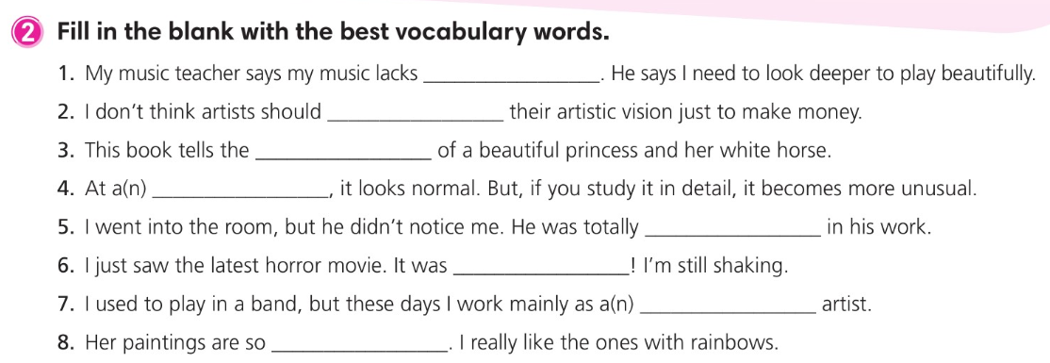
soul
compromise
tale
glance
absorbed
terrifying
solo
colorful

Slide 13
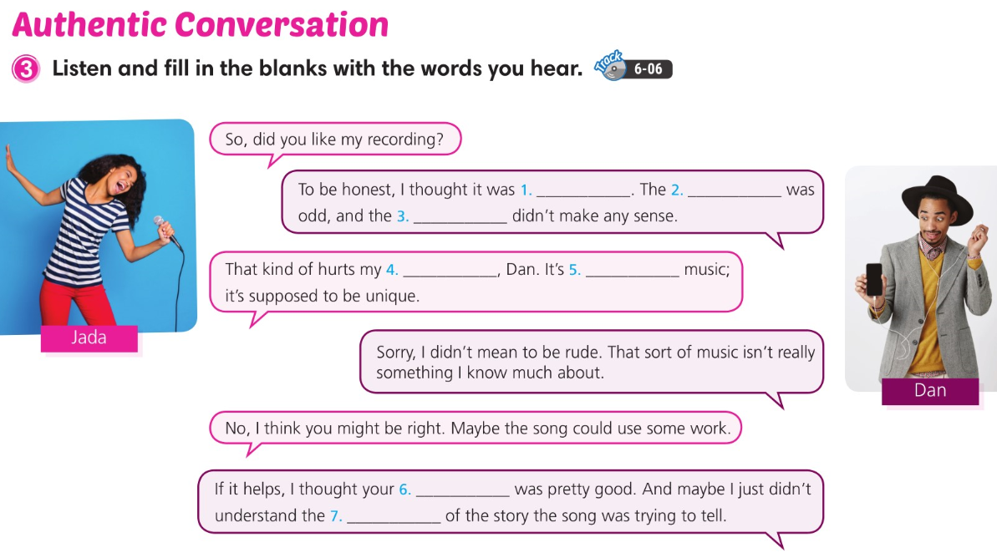
bizarre
rhythm
lyrics
feelings
contemporary
tone
context

Slide 14
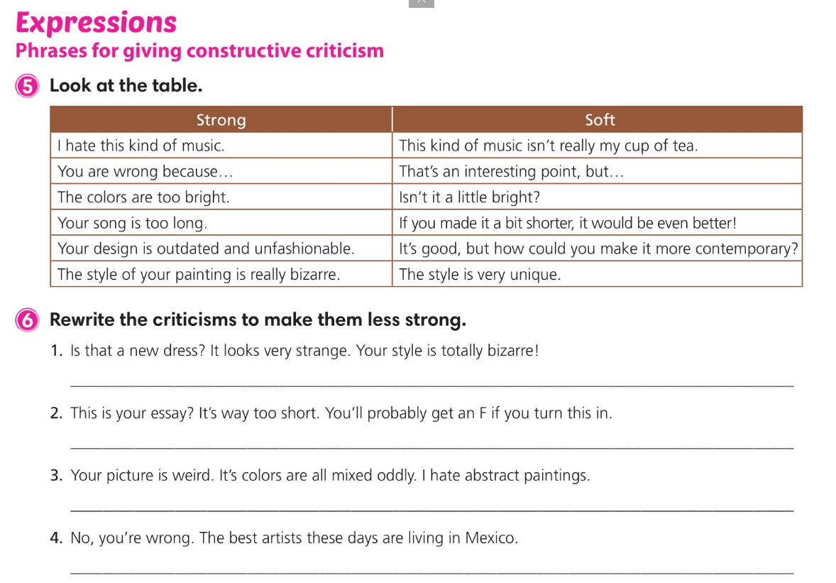
Is that a new dress? It’s very unique.
This is your essay? If you make it a bit longer, you’ll get a better grade on it.
Your picture is very unique, but abstract paintings aren’t my cup of tea.
That’s an interesting point, but I think the best artists are living in Mexico these days.

Slide 15
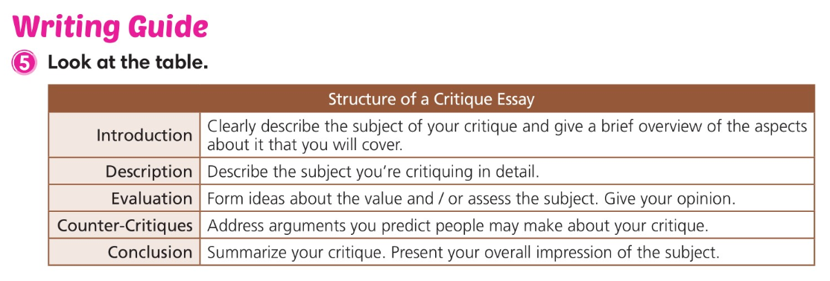

Slide 16
