Slide 1
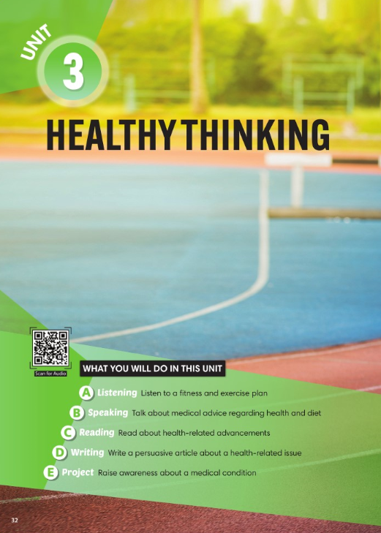
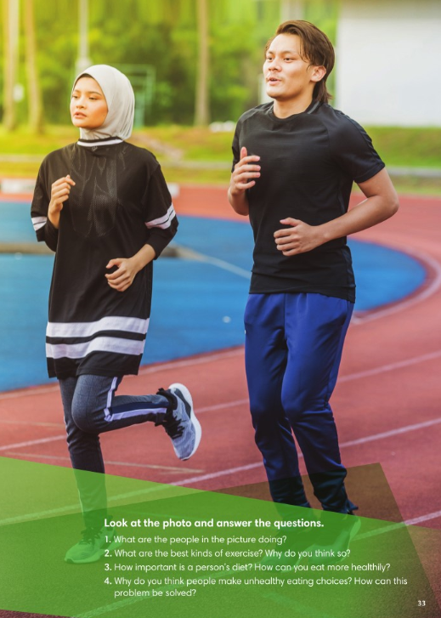

Slide 2
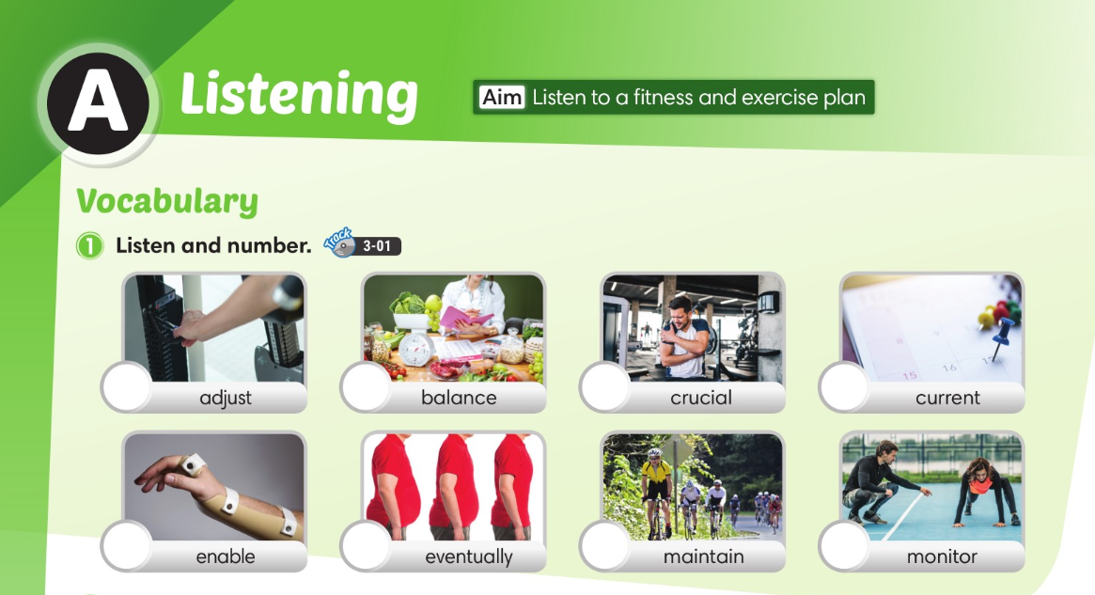

3
2
6
7
5
4
8
1

Slide 3
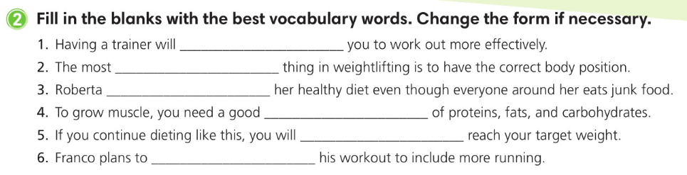
enable
crucial
maintains
balance
eventually
adjust

Slide 4
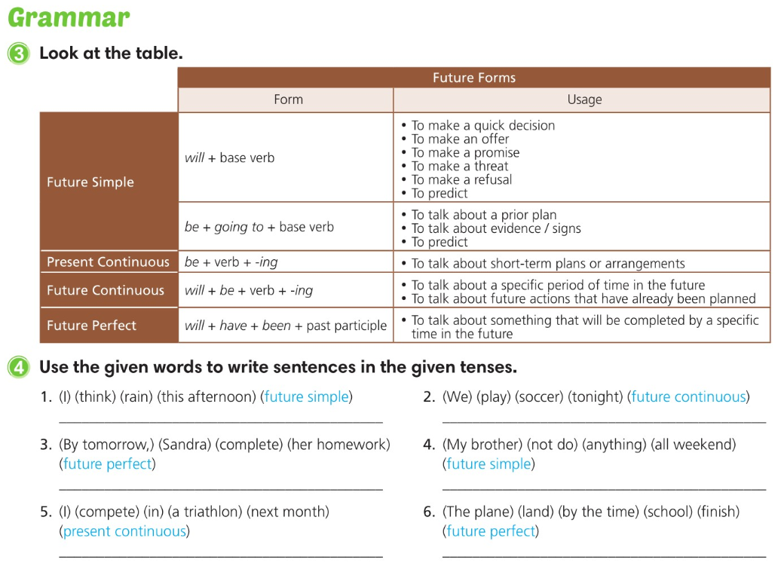
I think it will rain this afternoon.
We will be playing soccer tonight.
By tomorrow, Sandra will have completed her homework.
My brother won’t do anything all weekend.
I am competing in a triathlon next month.
The plane will have landed by the time
school finishes.

Slide 5
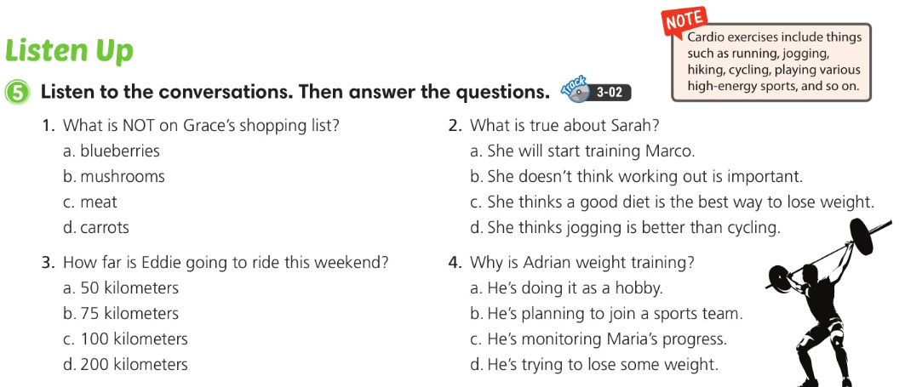

Slide 6
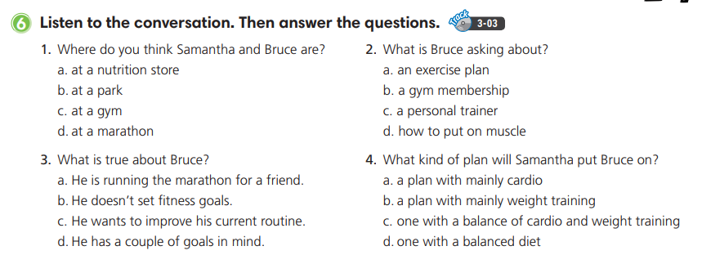

Slide 7
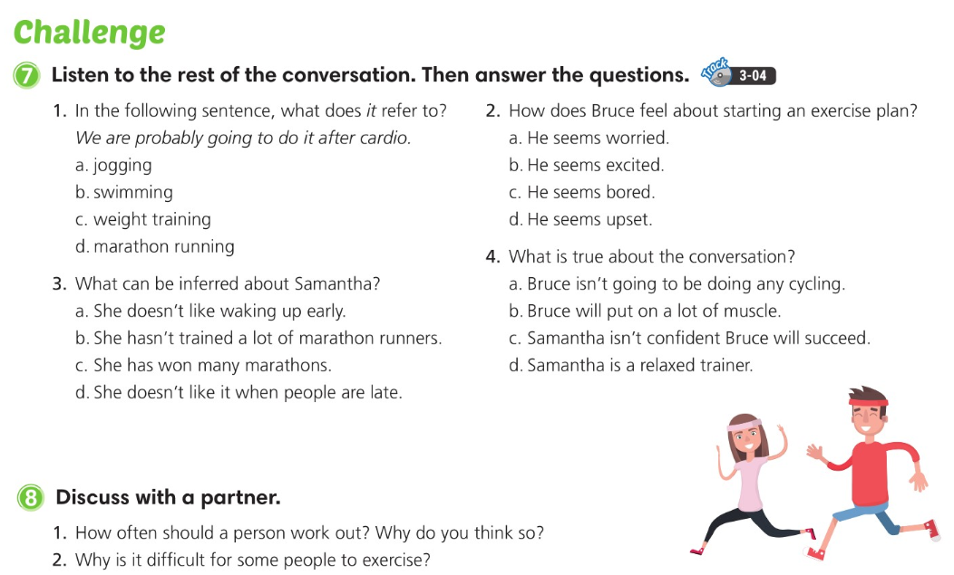

Slide 8
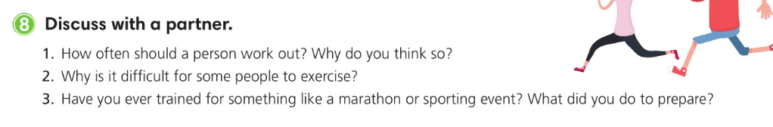

Slide 9
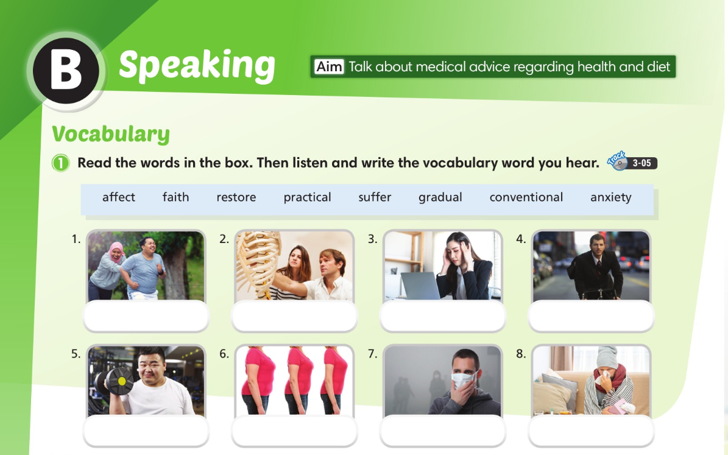
faith
restore
anxiety
practical
conventional
gradual
affect
suffering

Slide 10
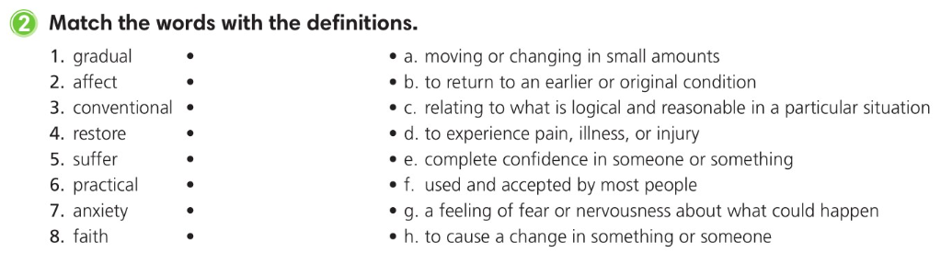

Slide 11
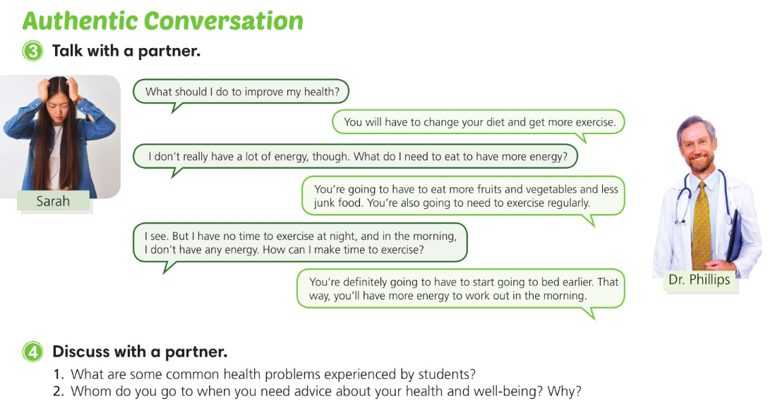

Slide 12
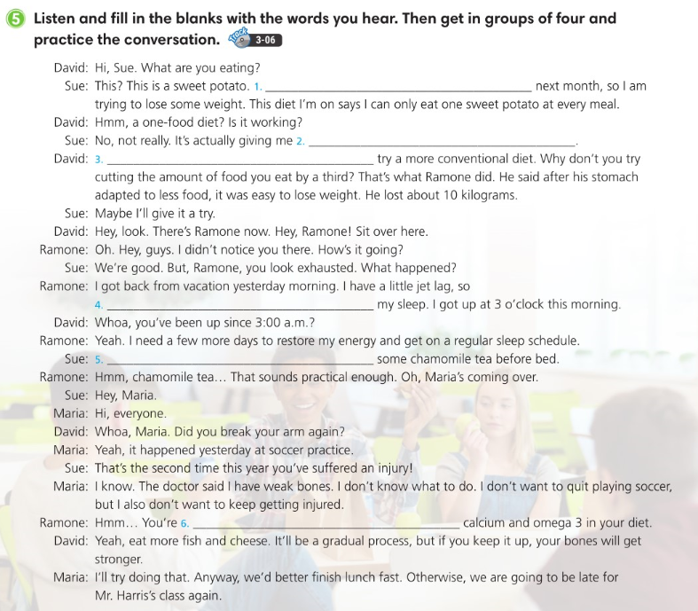
I’m going to the beach
a lot of anxiety
You’re going to have to
it’s been affecting
You should try drinking
going to have to get more

Slide 13
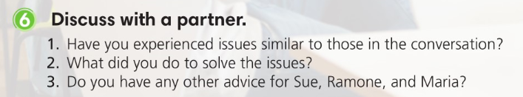

Slide 14
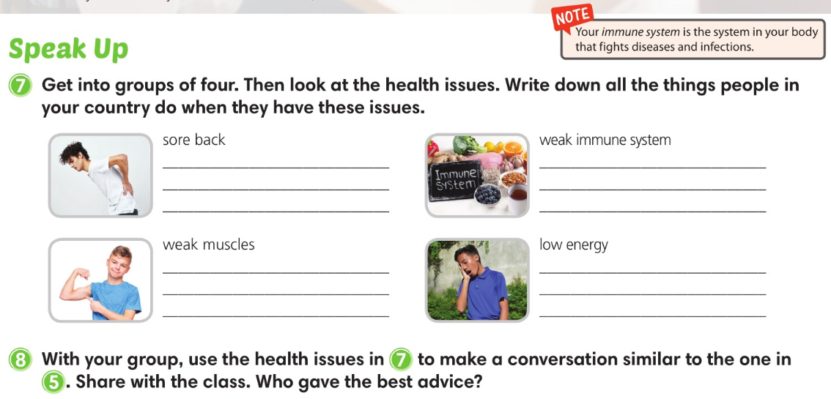

Slide 15

3
6
4
1
5
8
7
2

Slide 16
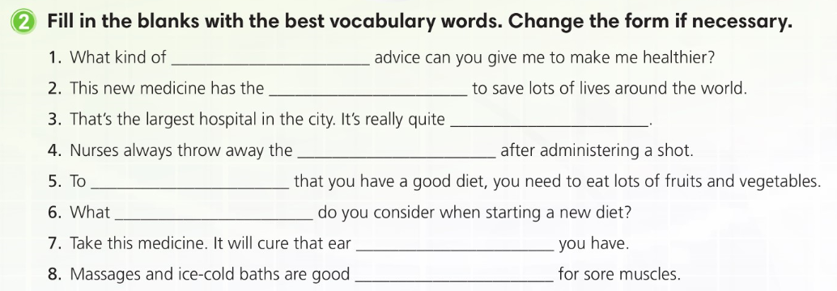
medical
potential
massive
needle
ensure
factors
infection
treatments

Slide 17
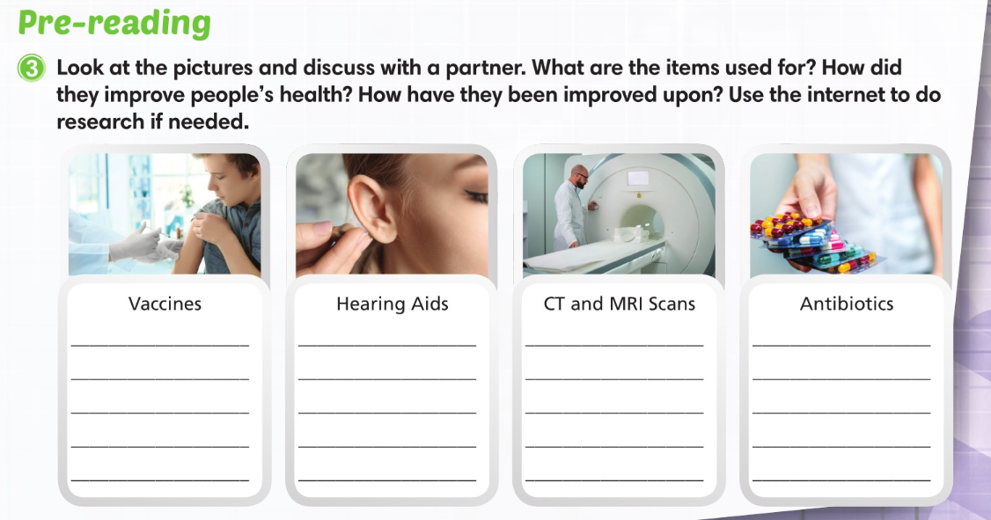

Slide 18
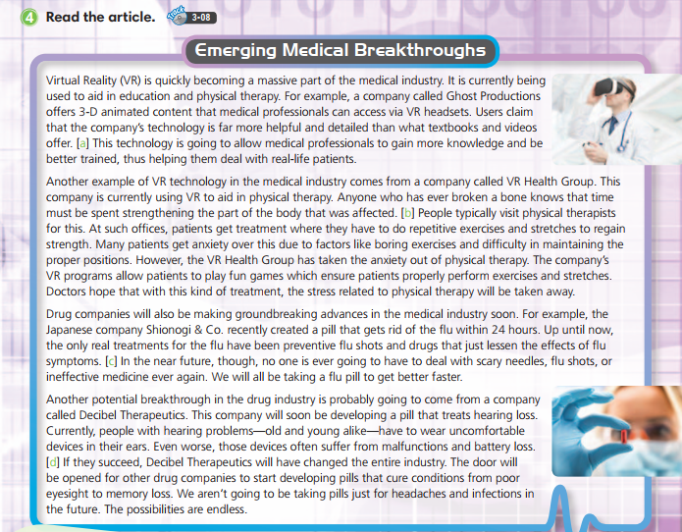

Slide 19
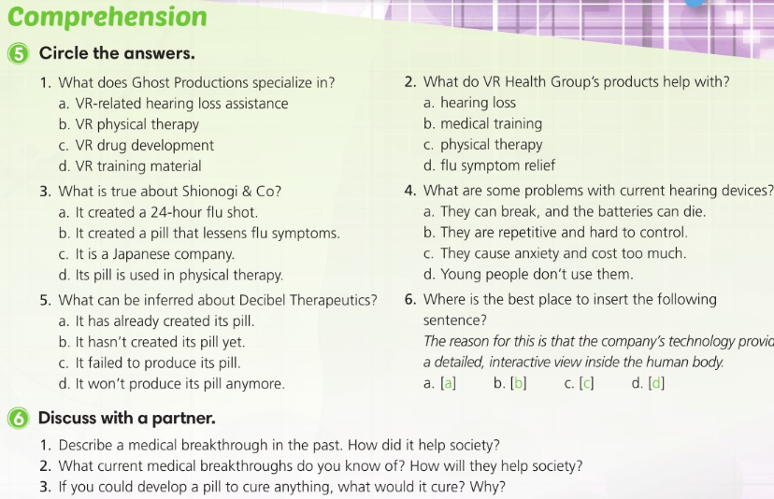

Slide 20
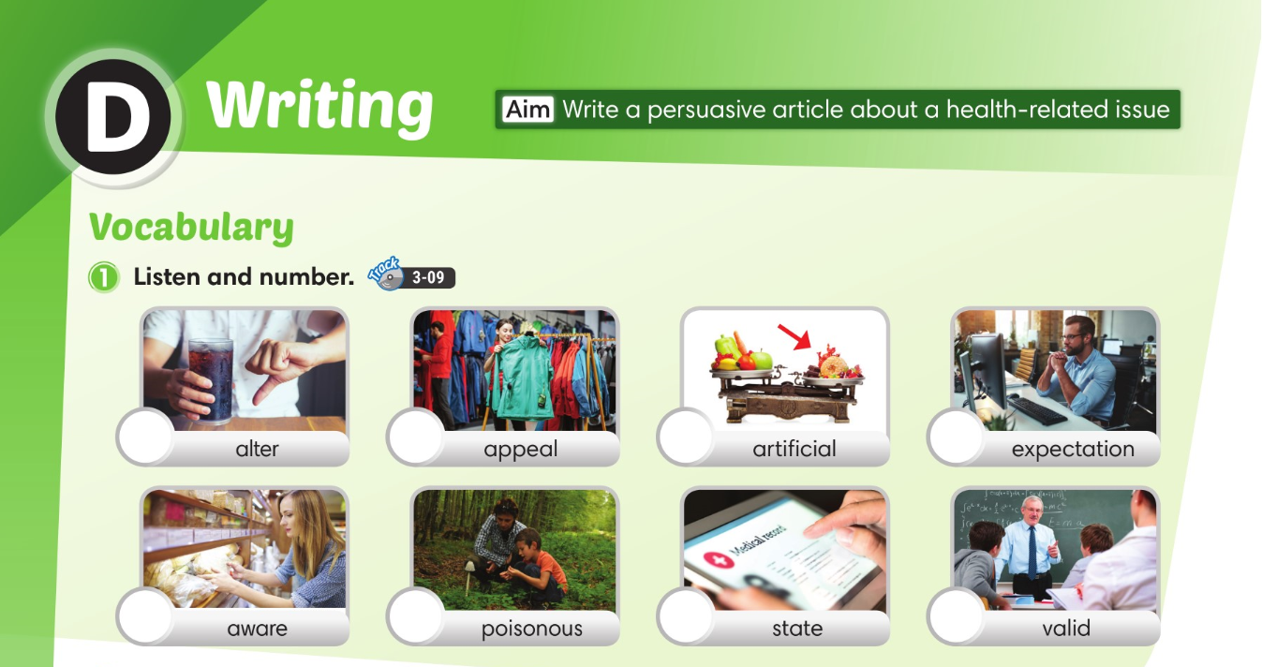
6
4
5
7
3
1
8
2

Slide 21
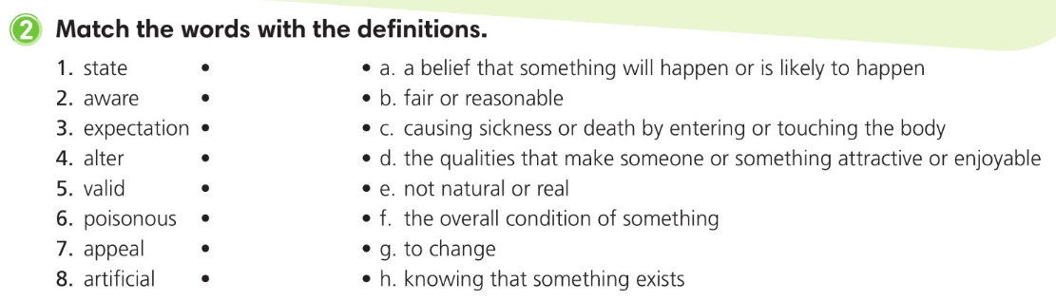

Slide 22
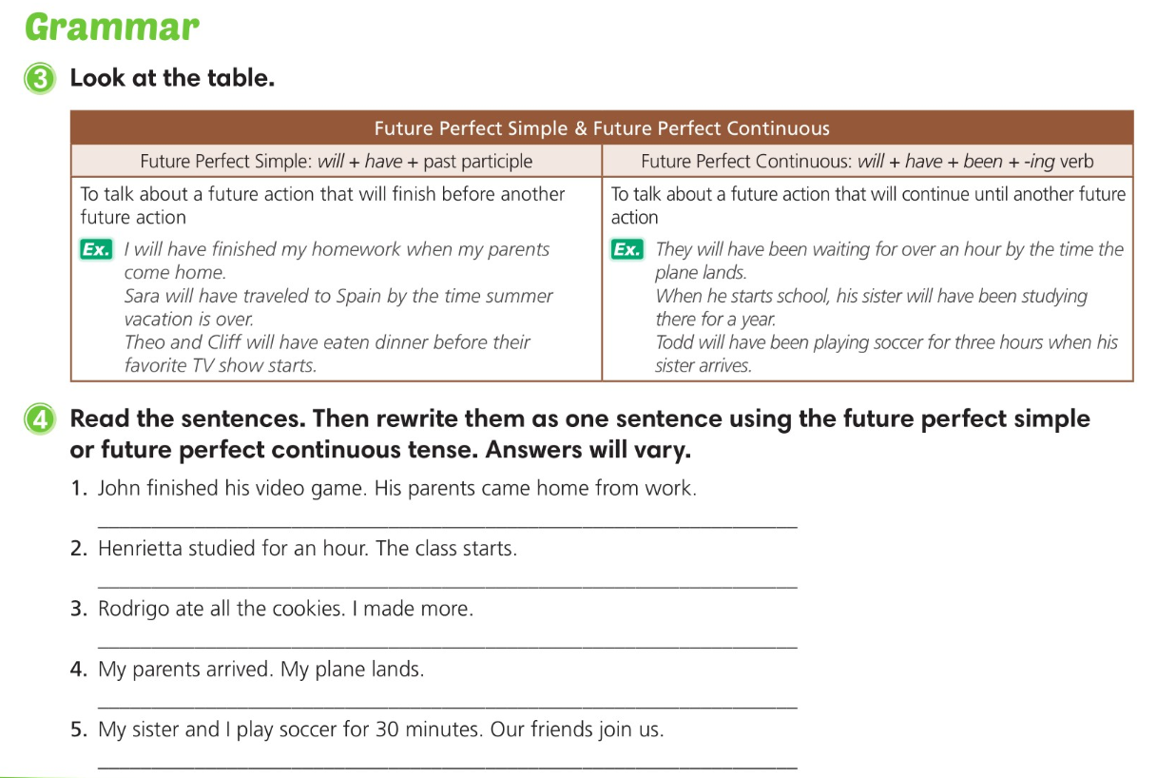
John will have finished his video game when his parents come home from work.
Henrietta will have studied for an hour before the class starts.
Rodrigo will have eaten all the cookies before I make more.
My parents will have arrived when my plane lands.
My sister and I will have been playing soccer for 30 minutes when our friends join us.

Slide 23
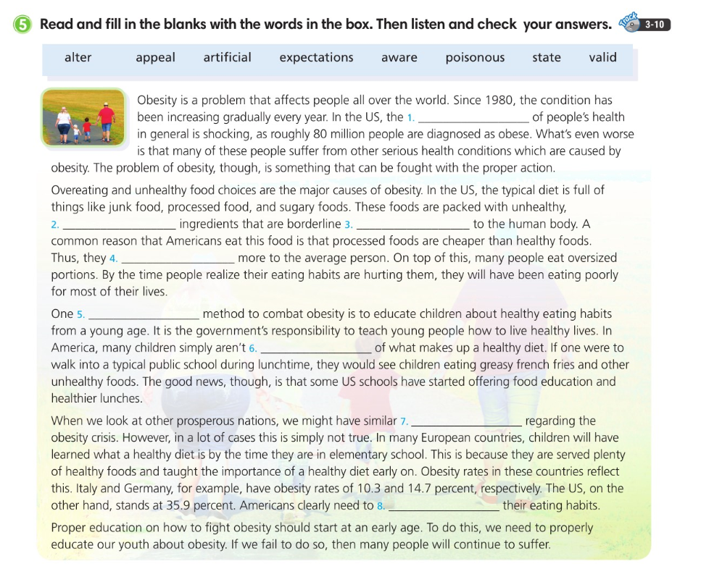
state
artificial
poisonous
appeal
valid
aware
expectations
alter

Slide 24
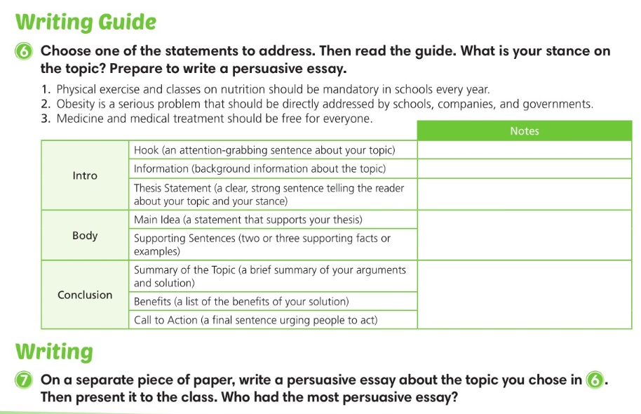

Slide 25
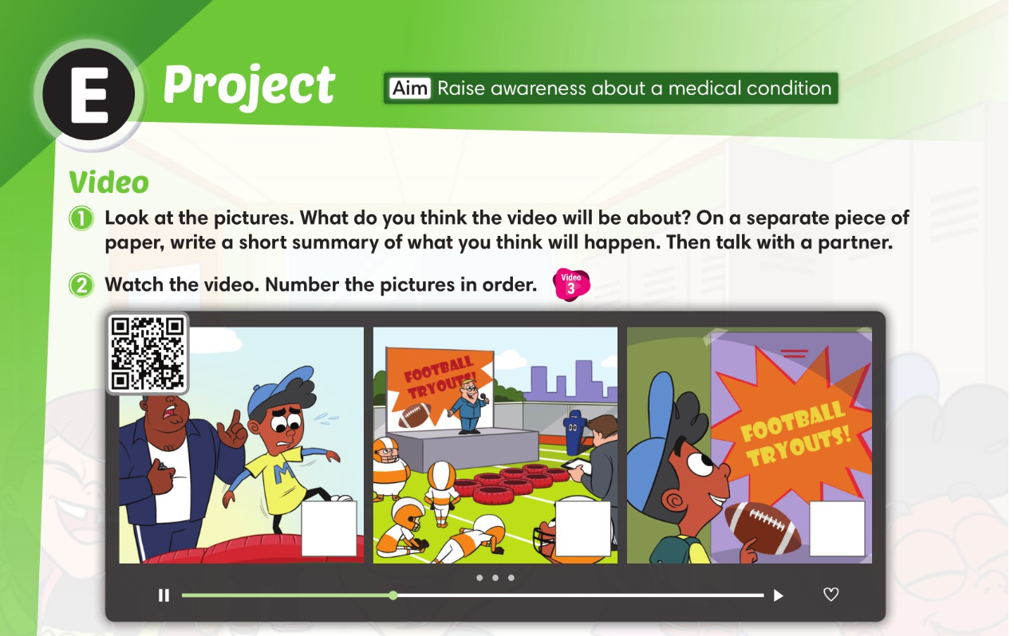
2
3
1

Slide 26
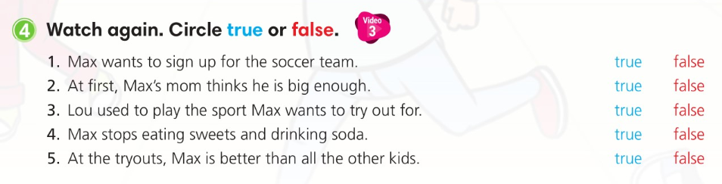

Slide 27
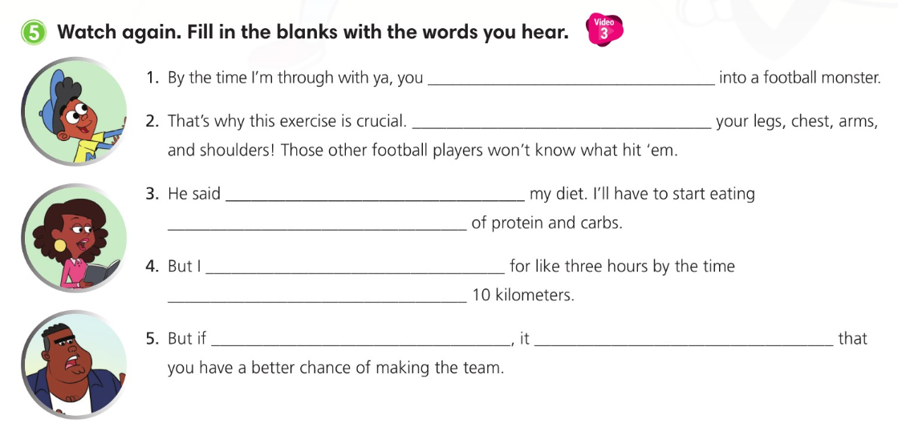
‘ll have turned
It’ll work out
I’ll need to adjust
a good balance
will have been running
I reach
you try your best
will ensure

Slide 28
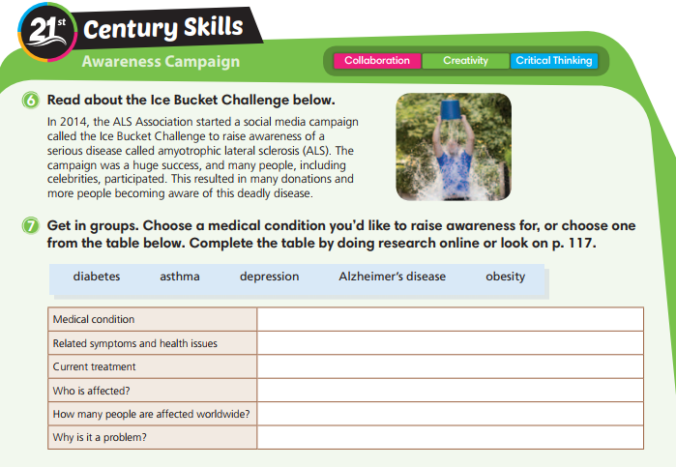

Slide 29
