Slide 1




Pronoun

Slide 3


Pronoun
You and me VS
You and I

Slide 4
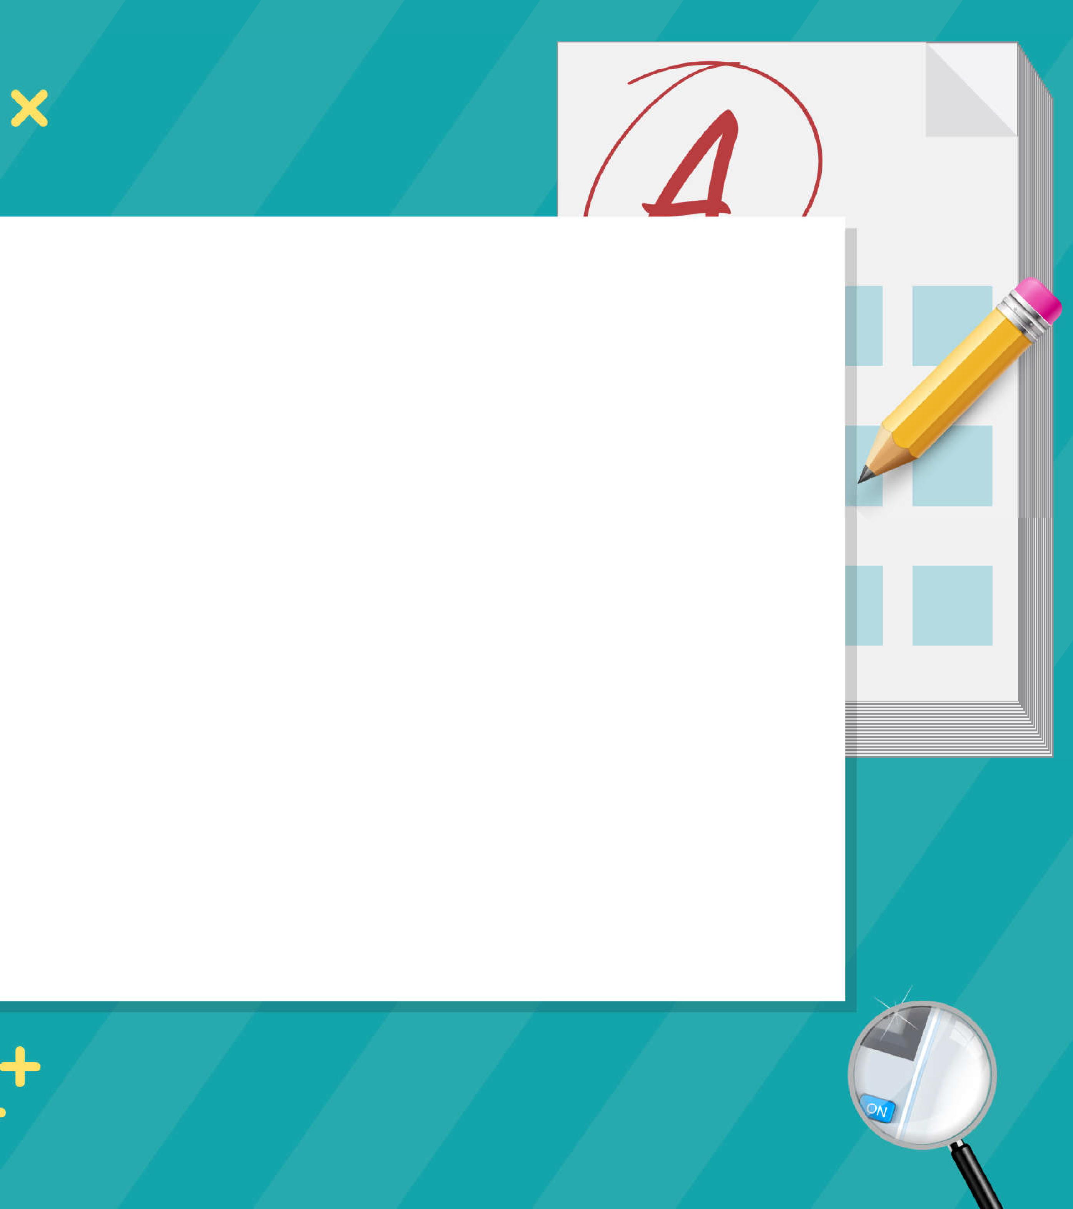
Exercise

Slide 5

Pronoun
Exercise
We all told the boss that we wanted to have
salaries paid in advance but he just ignored .
  ours / it
  his / we
  their / our
  we / his
  our / us

Slide 6
Pronoun
Exercise
When the man asked me how I had got address, I told him that I was given it by a relative of .
  my / me
  his / his
  mine / his
  his / him
  him / him

Slide 7
Pronoun
Exercise
I hope you will enjoy at the re-union party this weekend because I won't be able to be there .
  you / myself
  yourself / mine
  yours / oneself
  yourself / myself
  you / me

Slide 8
Pronoun
Exercise
We decided to do all the cooking instead of hiring a catering company for the party.
  of our own
  oneself
  by ourselves
  ours
  each other

Slide 9
Pronoun
Exercise
Thousands of children nowadays prefer doing
homework with a background of pop-music to doing
in a quiet room.
  theirs / them 4) his / its
  them / it’s 5) they / them
  their / it

Slide 10
Pronoun
Exercise
You and brother eed to take time to prepare
for the long journey which will start next month.
  his / yourself
  yours / ourselves
  their / you
  your / yourselves
  her / by themselves

Slide 11
Pronoun
Exercise
The kids watched each g sture of as if their mother were a stranger.
  them
  hers
  him
  her
  himself

Slide 12
Pronoun
Exercise
Trademarks enable a com any to distinguish
products from of another company.
  their / it
  it / that
  our / this
  its / those
  my / these

Slide 13
Pronoun
Exercise
What does ‘it’ refer to?
Tom has just closed the post office and turned it into a coffee shop.
  Tom
  post office
  coffee shop

Slide 14
Pronoun
Exercise
10. What does ‘they’ refer to?
I asked at several shops for strawberries and the owners all told me they are out of season.
shops
strawberries
owners

Slide 15
Pronoun
Exercise
‘Time to go to school, Jane. Have you got your keys?’ 'I can't find ’
  their
  them
  they
  it
  its

Slide 16
Pronoun
Exercise
12. As (1) its standard of living (2) has improved, most American families (3) have become accustomed
(4) to enjoying creature comforts previous generations only (5)dreamed of.

Slide 17
Pronoun
Exercise
13. Video games in the (1) early eighties (2) they became one of the (3) most sensational
(4) growth industries (5) ever in the United States.

Slide 18
Pronoun
Exercise
14. Businessman will (1) remain hesitant (2) to borrow money from banks for investing (2) in (3) their companies while interest rates (4)stay a high level.

Slide 19
Pronoun
Exercise
15. (1) The rose (2) is believed (3) to have been the first flower (4) cultivated by man, perhaps (5) because was the first to be doubled.

