Slide 1



Slide 2









Slide 3





Slide 4



Slide 5






Slide 6
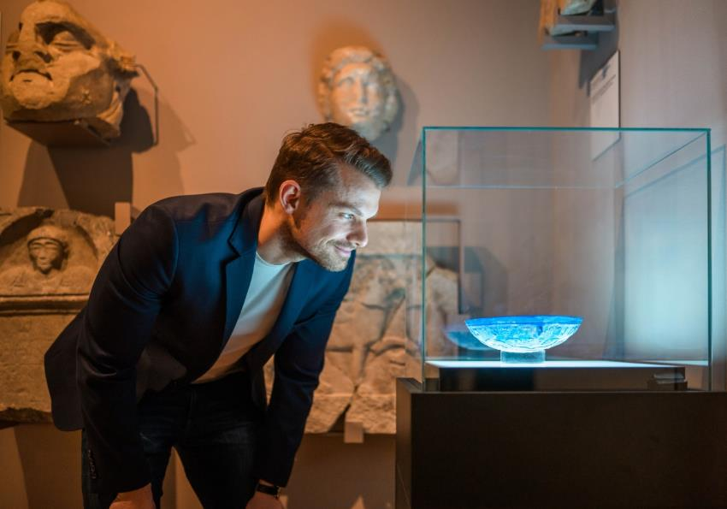




Slide 7










Slide 8








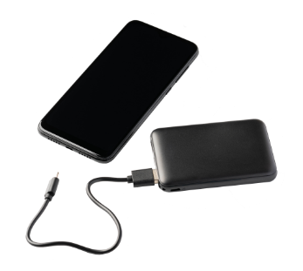



Slide 9
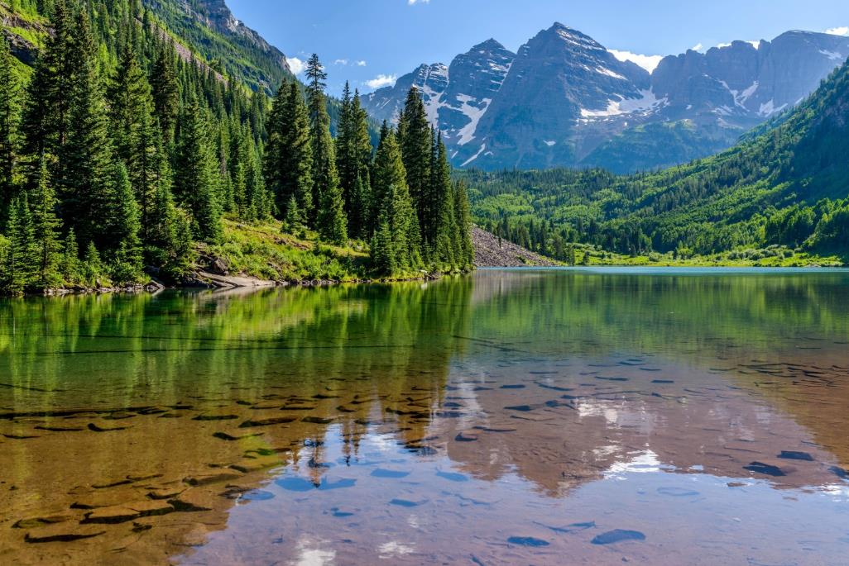


Slide 10
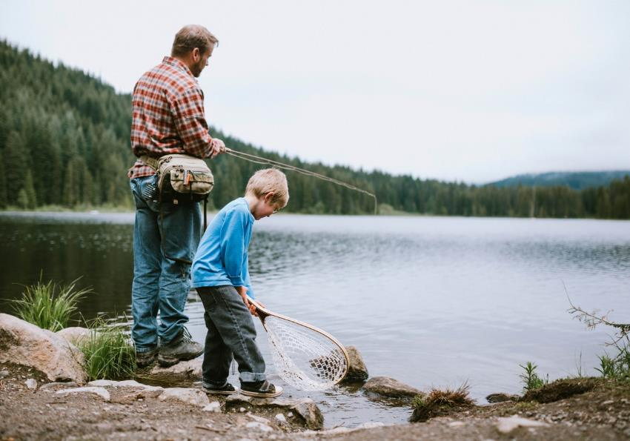
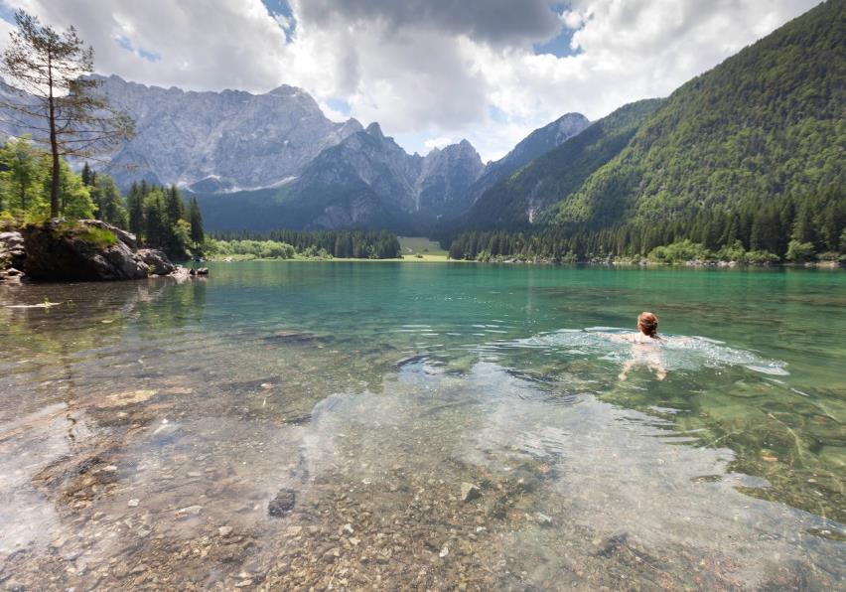



Slide 11
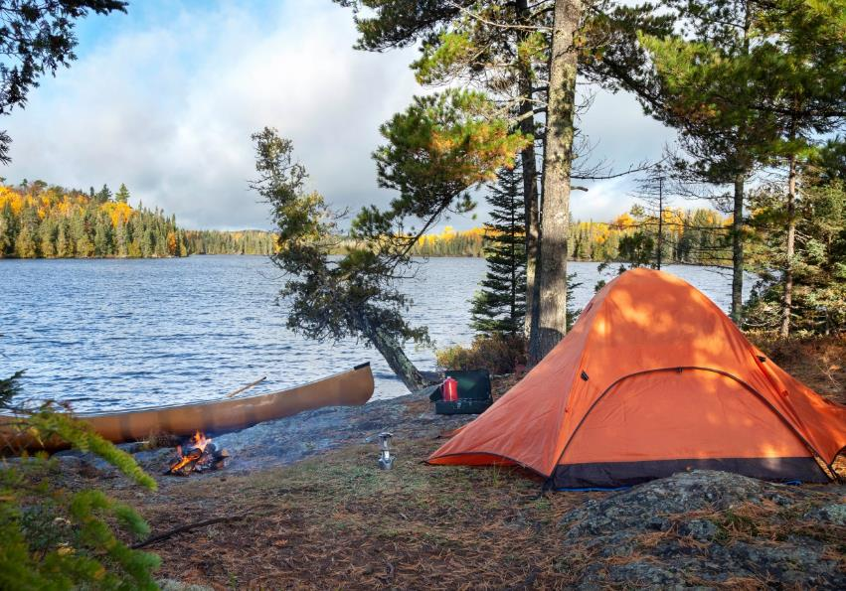




Slide 12









Slide 13
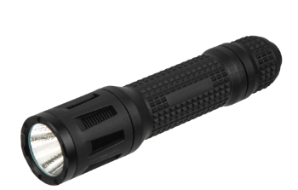
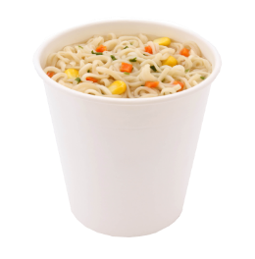

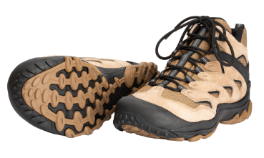






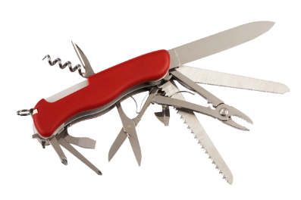




Slide 14



Slide 15





Slide 16





Slide 17








Slide 18


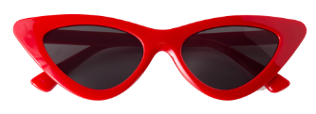



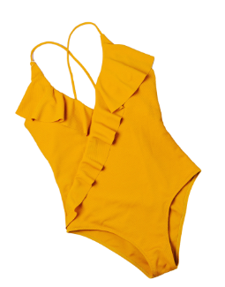
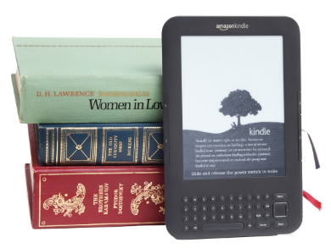
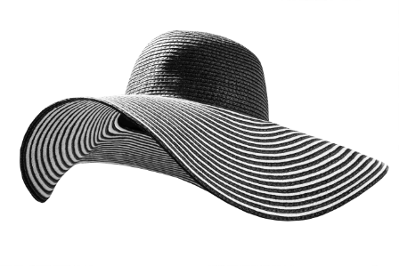




Slide 19



Slide 20

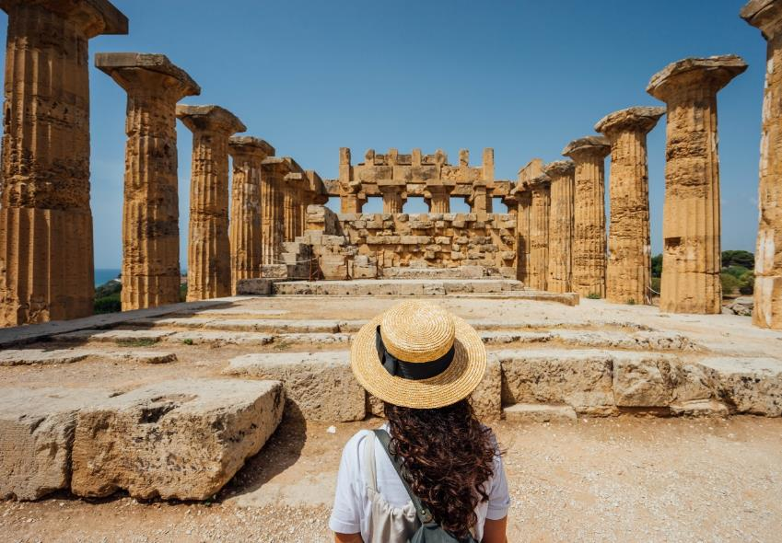



Slide 21

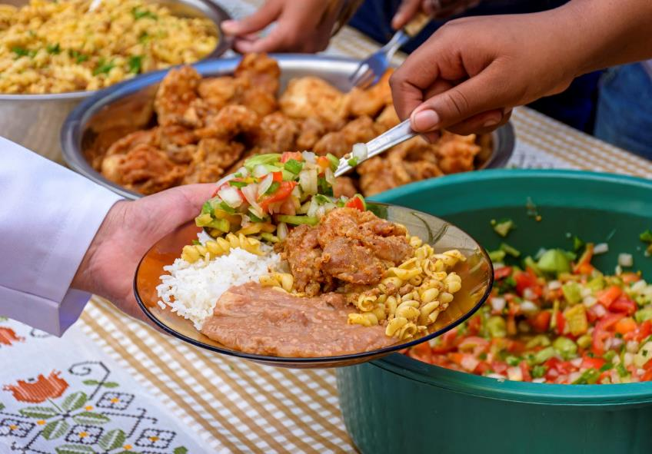



Slide 22







Slide 23
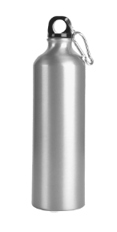

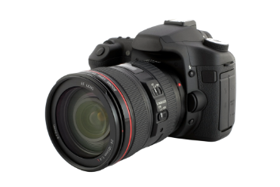










Slide 24



Slide 25





Slide 26





Slide 27








Slide 28

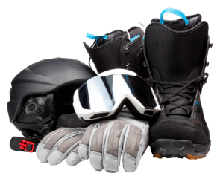


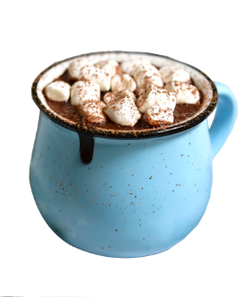
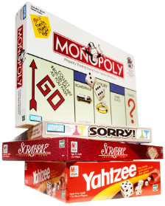



Slide 29
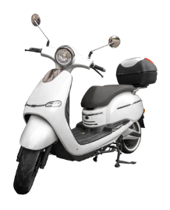












Slide 30









Slide 31








Slide 32
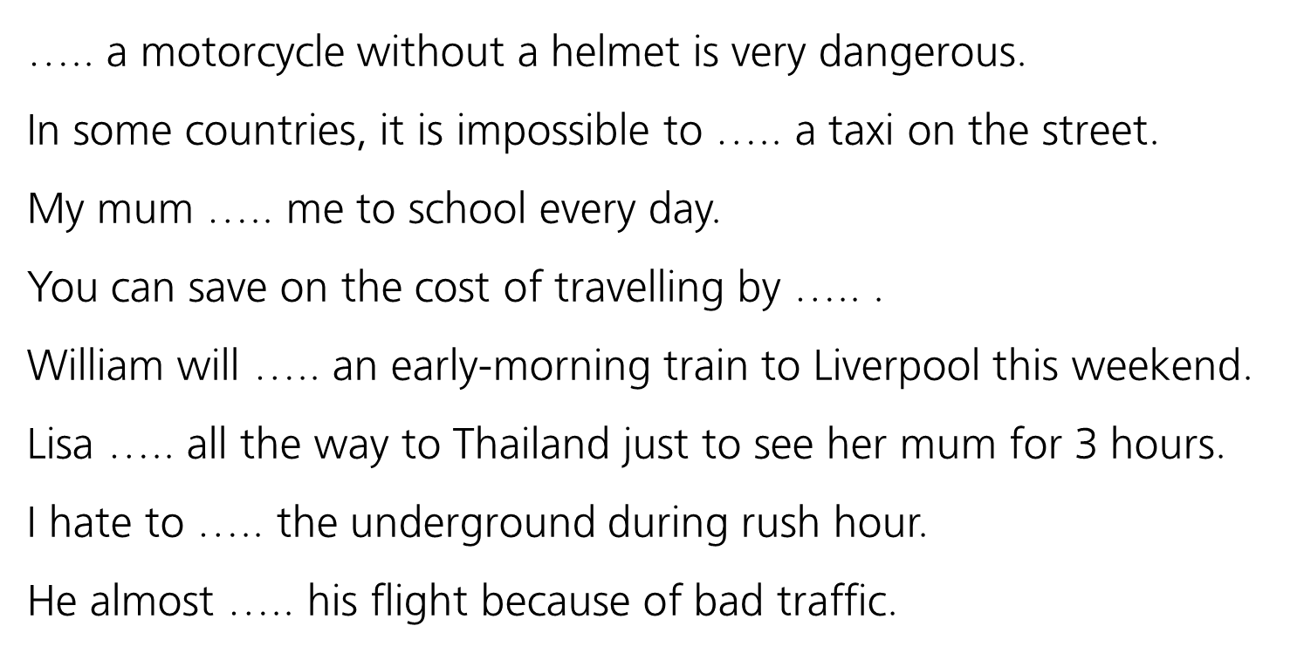
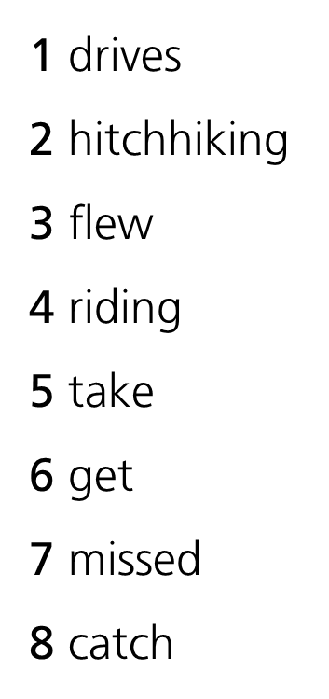









Slide 33















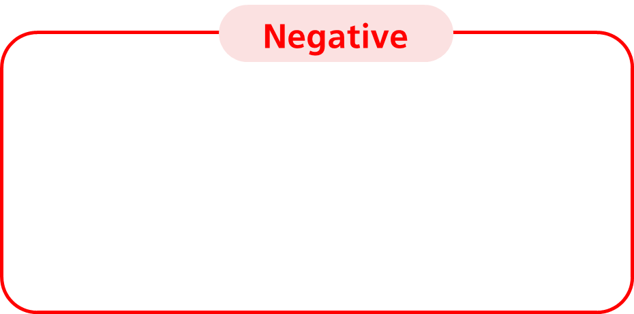

Slide 34









Slide 35




Slide 36




Slide 37

















Slide 38



Slide 39

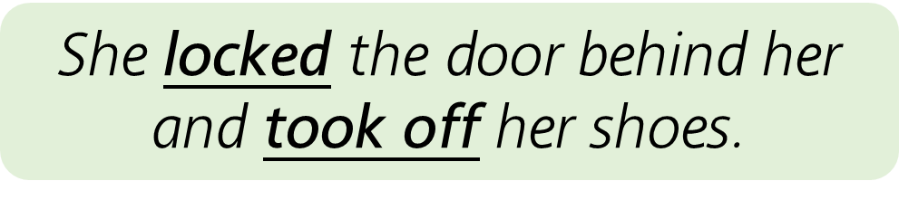

Slide 41



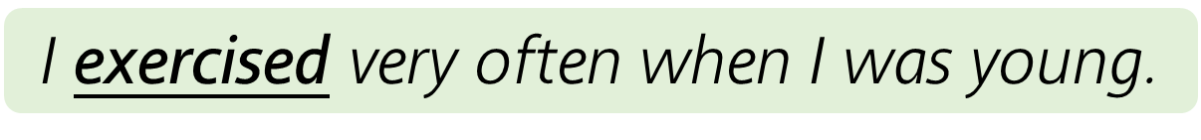


Slide 42




Slide 43
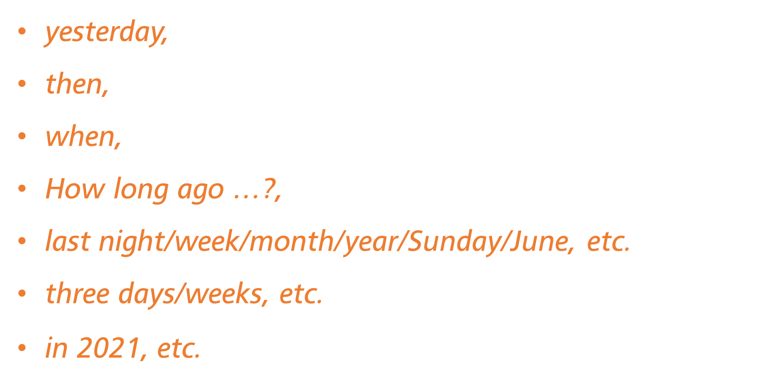

Slide 44




Slide 45



Slide 46




Slide 47



Slide 48

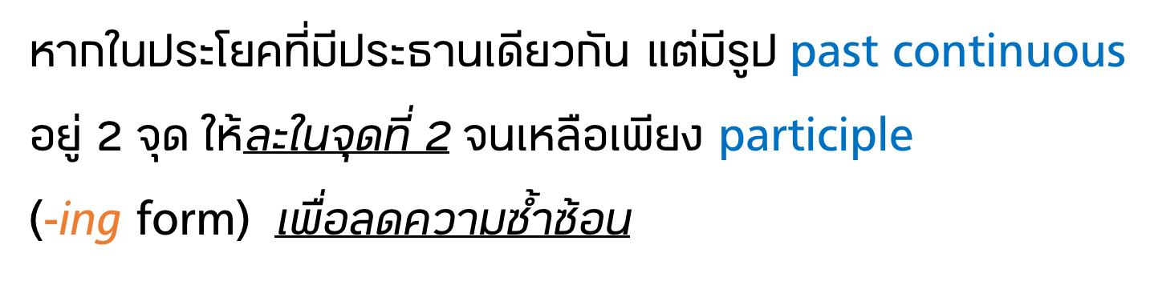




Slide 49


Slide 50




Slide 51
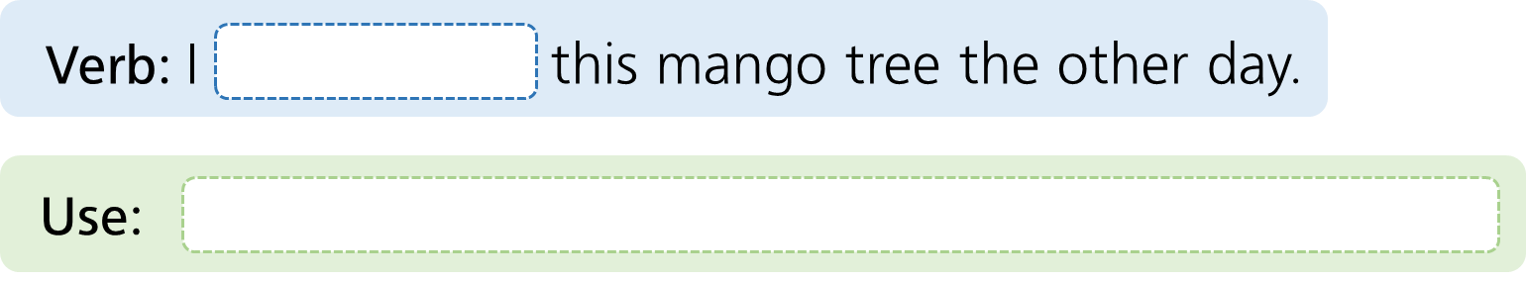



Slide 52




Slide 53
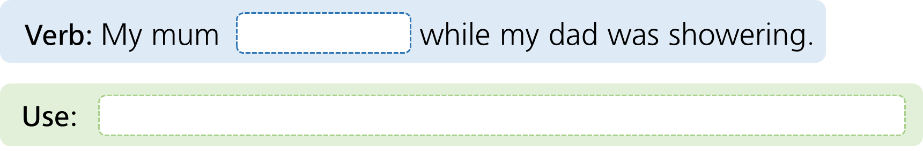



Slide 54
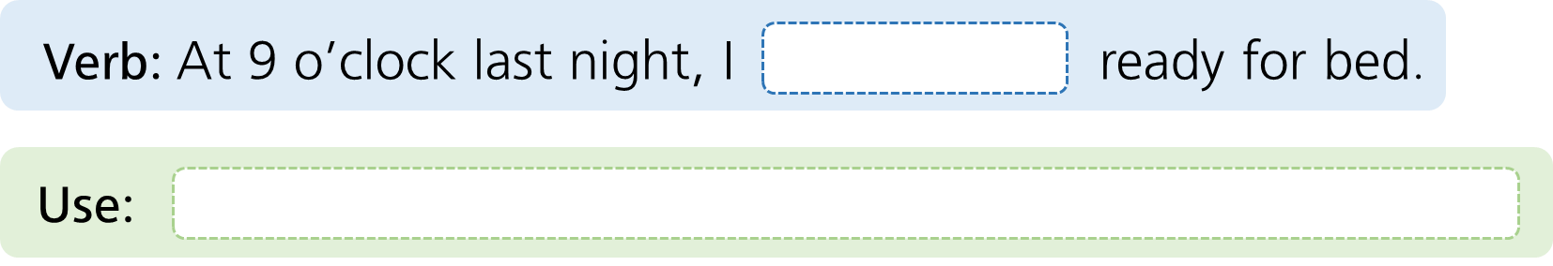



Slide 55


Slide 56
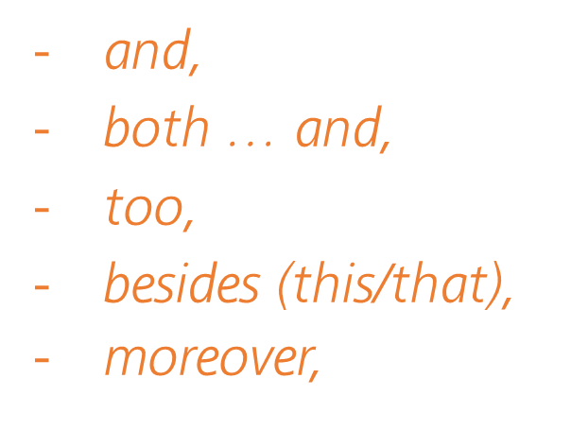
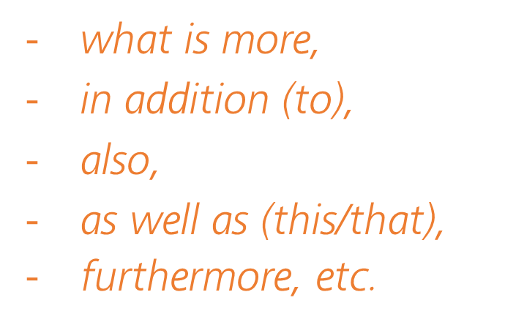



Slide 57
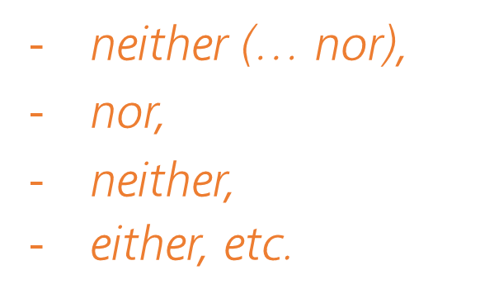



Slide 58
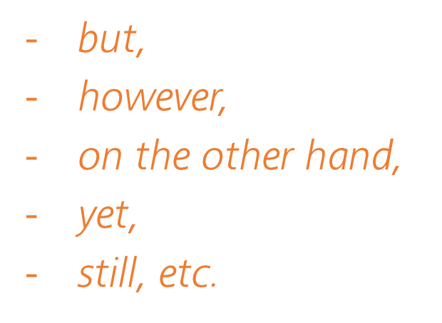
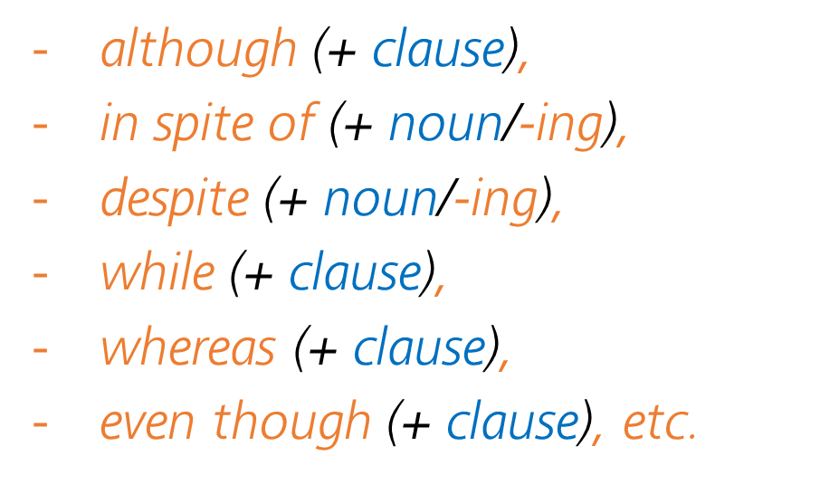


Slide 59





Slide 60
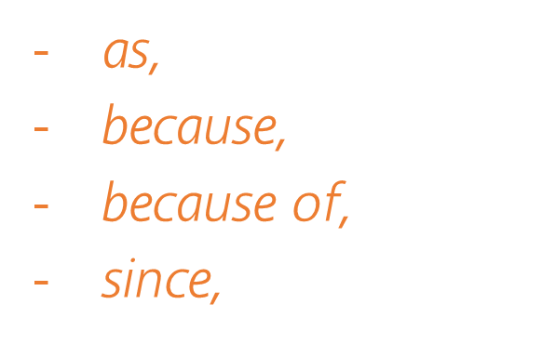
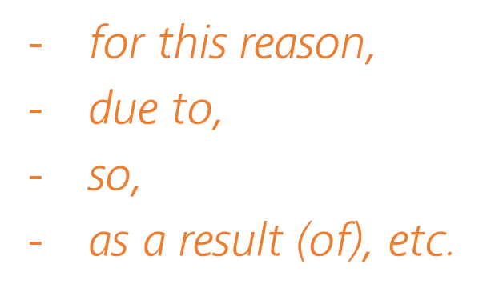



Slide 61
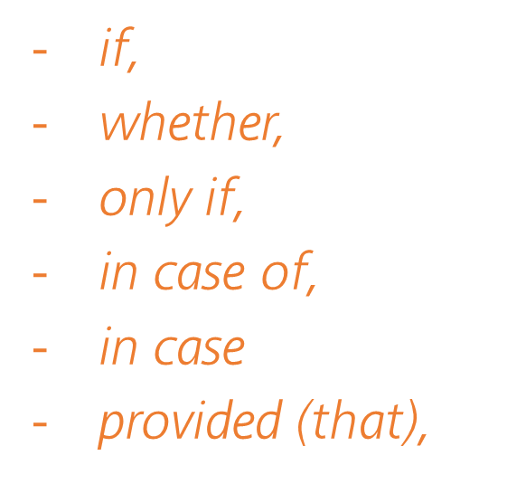
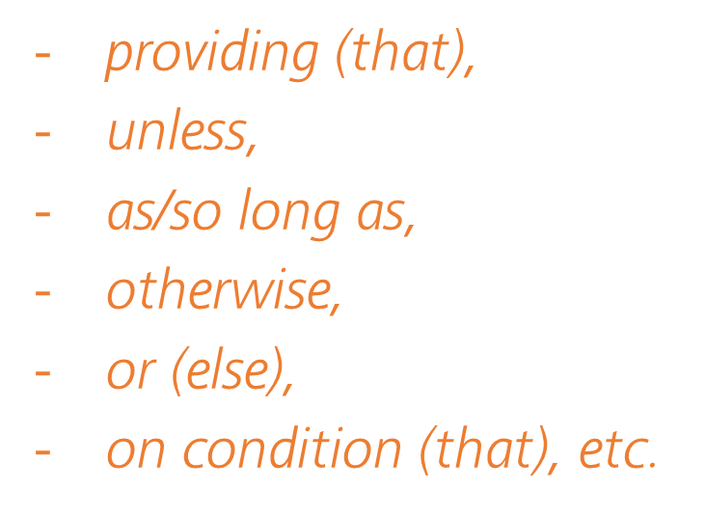



Slide 62
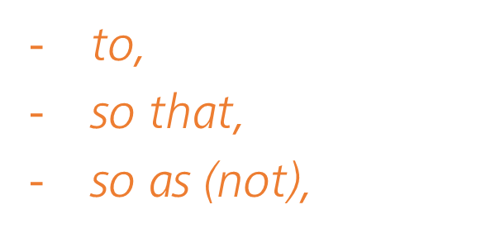
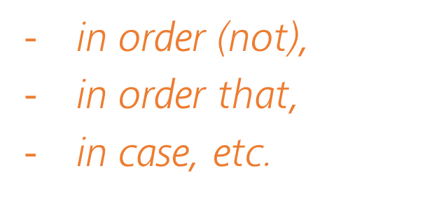



Slide 63
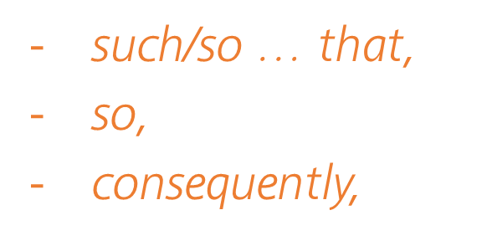
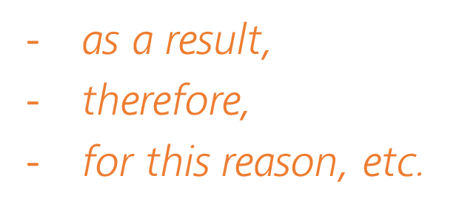



Slide 64
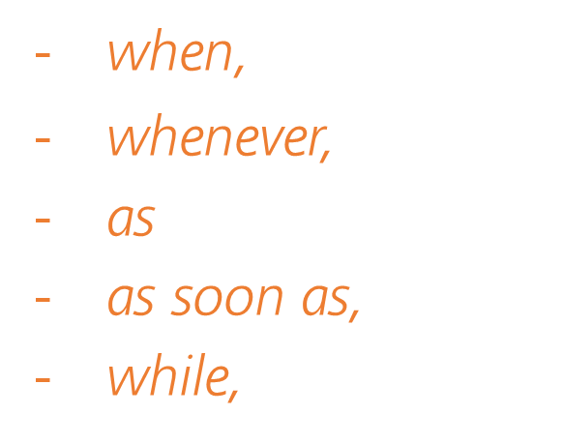
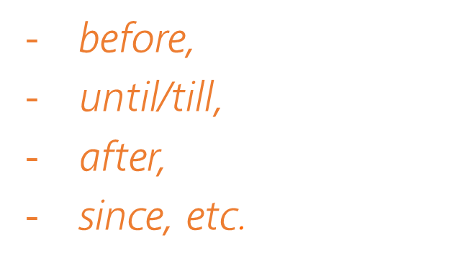



Slide 65






Slide 66







Slide 67



Slide 68




Slide 69
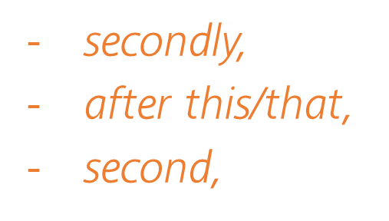



Slide 70


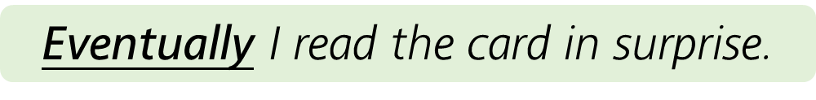

Slide 71
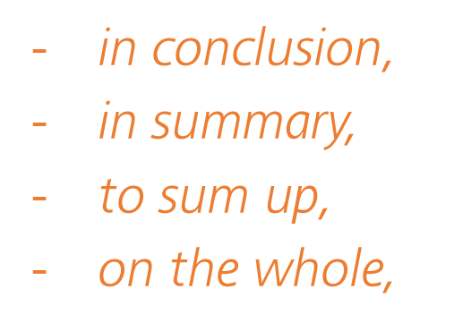




Slide 72




Slide 73


Slide 74


Slide 75



Slide 76


Slide 77


Slide 78



Slide 79


Slide 80






Slide 81






Slide 82







Slide 83











Slide 84








Slide 85







Slide 86




Slide 87







Slide 88






Slide 89







Slide 90





Slide 91




Slide 92




Slide 93



Slide 94






Slide 95













Slide 96







Slide 97







Slide 98






Slide 99






Slide 100




Slide 101






Slide 102


Slide 103


Slide 104


Slide 105


Slide 106


Slide 107






Slide 108




Slide 109







Slide 110





Slide 111







Slide 112






Slide 113






Slide 114










Slide 115








Slide 116








Slide 117














Slide 118











Slide 119





Slide 120





Slide 121






Slide 122




It’s not very good.

Slide 123





Slide 124







Slide 125



Slide 126



Slide 127


