Slide 1
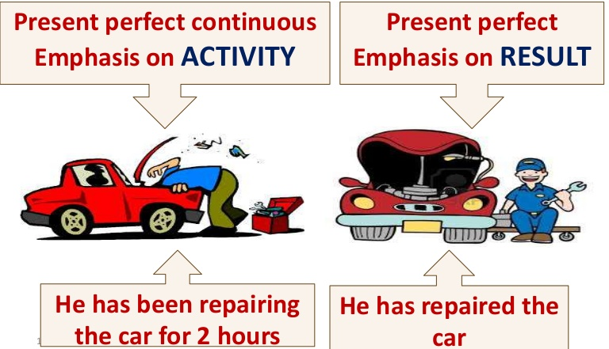
Present Perfect
vs
Present Perfect Continuous

Slide 2
Present Perfect Continuous
V
I
You
We
They
He
She
It
I have been waiting.
You have been waiting.
They have been waiting.
He has been waiting.
She has been waiting.
have (not)
has (not)
been
ing
Present Perfect
I
You
We
They
He
She
It
V
I have left/ repaired.
You have left/ repaired.
They have left/ repaired.
He has left/ repaired.
She has left/ repaired.
have (not)
has (not)
3 (irregular)/
ed (regular)

Slide 3

Usage of Present Perfect Continuous
We have been painting the flat. That’s why it smells.
We still have 2 rooms to paint
to emphasize the duration of the action which started in the past and may or may not be completed by now

Slide 4

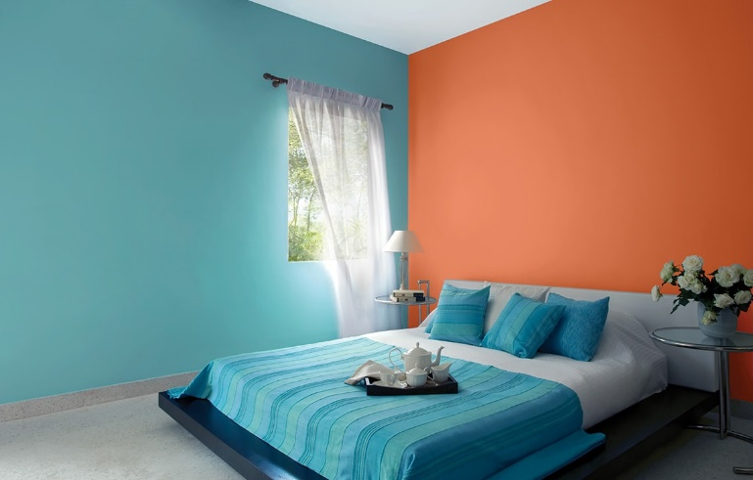

Usage of Present Perfect
We have painted the flat.
All the rooms are painted now.
to emphasize the result of the action which is complete now

Slide 5
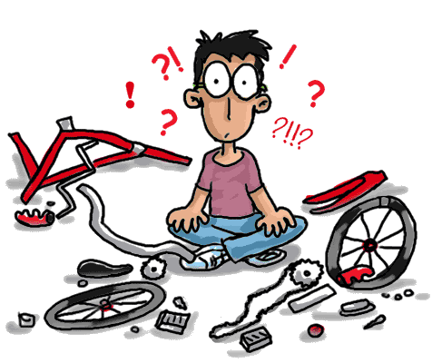
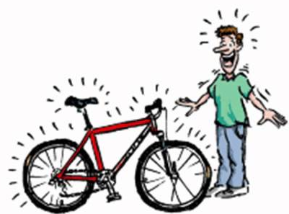
Usage and difference
Present Perfect Continuous
Present Perfect
Tom has been mending his bike all day.
Tom has mended his bike.

Slide 6
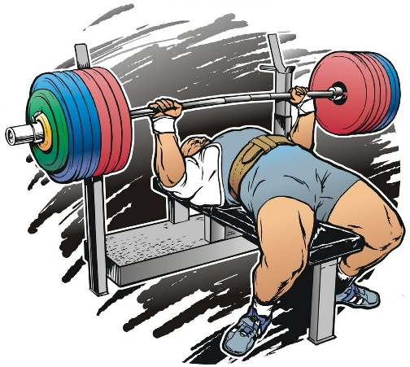

Usage and difference
Present Perfect Continuous
Present Perfect
Tim has been going to the gym for the last 3 months. (repeated action over a period of time)
Tim has lost 5 kilos.
He has been driving for 5 hours.
He has driven 500 kilometers so far.
She has been reading for 2 days.
She has read 200 pages of the book.
It has been raining for all day.
The road is wet. The rain has just stopped.

Slide 7
Common mistakes
I have been cutting my finger. It hurts.
I have cut my finger. It hurts.
I have been falling from the tree.
I have fallen from the tree.
He has been breaking his leg.
He has broken his leg.
!!! Short actions aren’t used in Present Perfect Continuous

Slide 8
Common mistakes
I have been knowing him all my life.
I have known him all my life.
I have been believing in God since childhood.
I have believed in God since childhood.
This house has always been belonging to our family.
This house has always belonged to our family.
!!!State verbs aren’t used in Present Perfect Continuous

Slide 9
work, teach, live...
I have taught here for 2 years.
=
I have been teaching here for 2 years.

Slide 10
for/ since
We have been waiting for 2 hours.
for + period of time
now
We have been waiting since 11 am.
since + point of time
now

Slide 11
for/ since?
since
for
… 1. I was born
… 2. a long time
for
since
… 3. 10 years
… 4. 4 o’clock
since
… 5. I moved to New York
for
… 6. ages
since
… 7. yesterday
since
… 8. 6 p.m

Slide 12

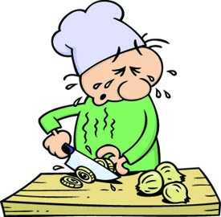
- Why are you sweating?
- Because I ….
have been sweeping the floor.
- Are the floors clean?
sweep floor(s)
- Yes, Tim…
has swept the floors.
- Are the onions ready?
- Yes, I ….
have peeled them.
- Why are your eyes red?
- Yes, I ….
have been peeling the onions.
peel onions

Slide 13


- Why do you look so tired?
- Because I ….
have been cutting the grass.
- Is the lawn finished?
- Yes, I ….
have cut the grass.
- Why do you have paints on your hands?
- Because I ….
have been painting a picture for an hour.
- Is the picture ready?
- Yes, I ….
have drawn the picture.

Slide 15
Common mistakes
I have been cutting my finger. It hurts
I have cut my finger. It hurts
I have fallen from the tree
I have been falling from the tree
He has been breaking his leg
He has broken his leg
!!! Short actions aren’t used in Present Perfect Continuous

Slide 16
Common mistakes
I have known him all my life
I have been knowing him all my life
I have been believing in God since childhood
I have believed in God since childhood
This house has always belonged to our family
This house has always been belonging to our family
!!!State verbs aren’t used in Present Perfect Continuous

