Slide 1





Slide 2









Slide 3



Slide 4
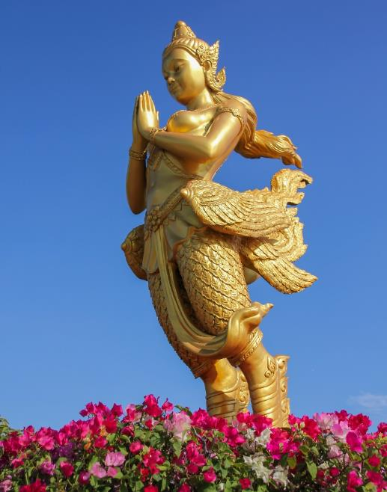





Slide 5
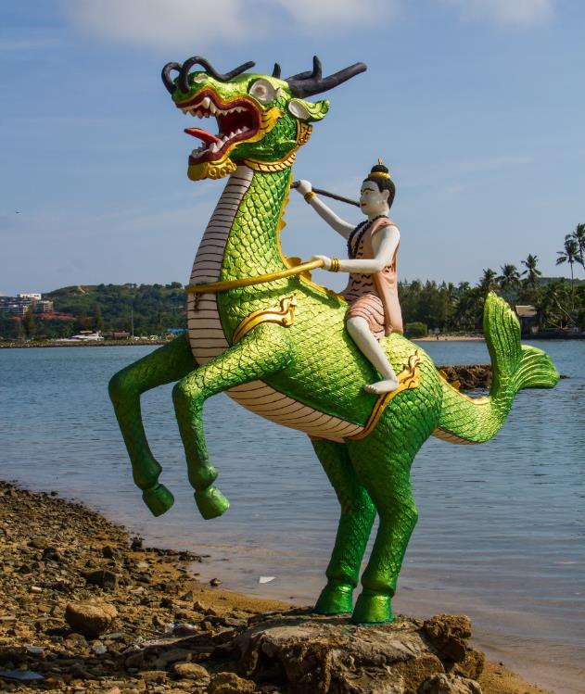





Slide 6
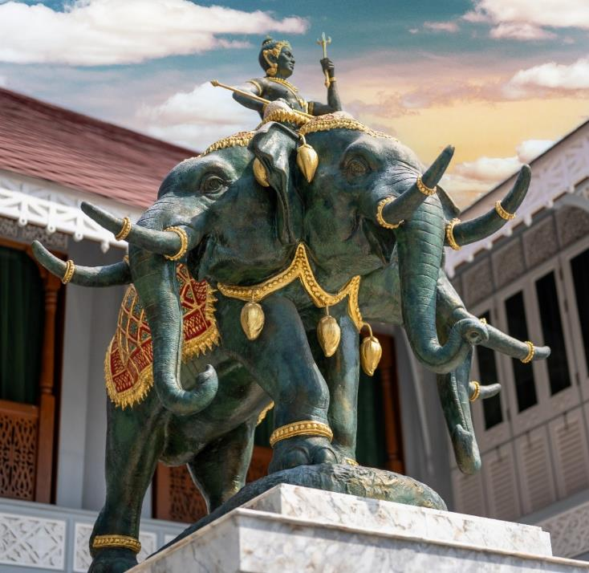





Slide 7
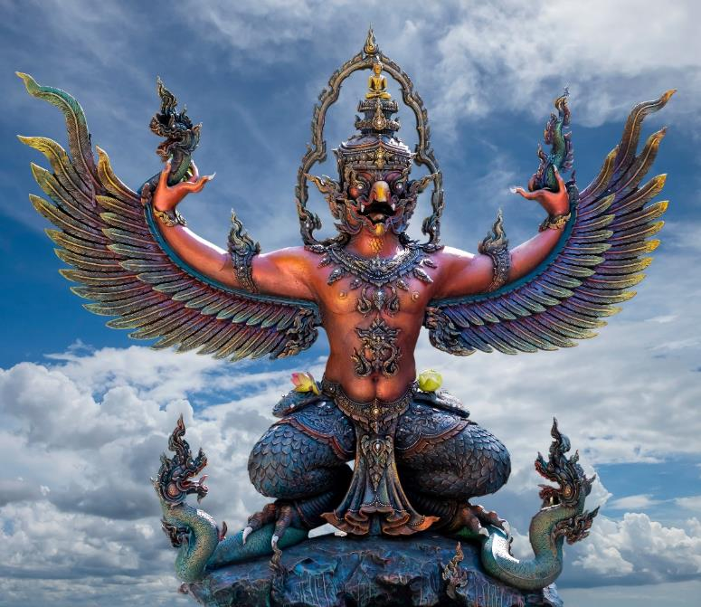





Slide 8










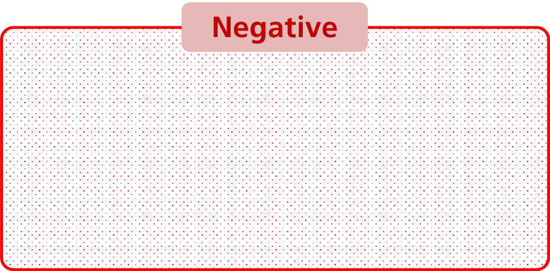

Slide 9















Slide 10

















Slide 11










Slide 12








Slide 13







Slide 14

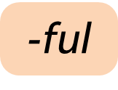
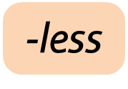

Slide 15
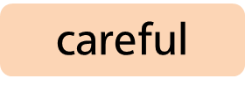

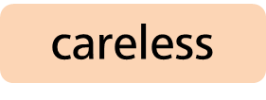














Slide 16


Slide 17




Slide 18


Slide 19



Slide 20



Slide 21



Slide 22


Slide 23


Slide 24



Slide 25




Slide 26




Slide 27



Slide 28





Slide 29
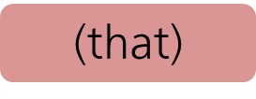
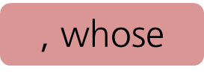

Slide 30

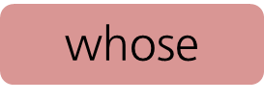

Slide 31
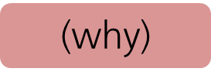


Slide 32



Slide 33




Slide 34



Slide 35






Slide 36





Slide 37





Slide 38








Slide 39




Slide 40





Slide 41





Slide 42







Slide 43








Slide 44






Slide 45








Slide 46





Slide 47






Slide 48






Slide 49





Slide 50




Slide 51


Slide 52



Slide 53



Slide 54







Slide 55







Slide 56



Slide 57
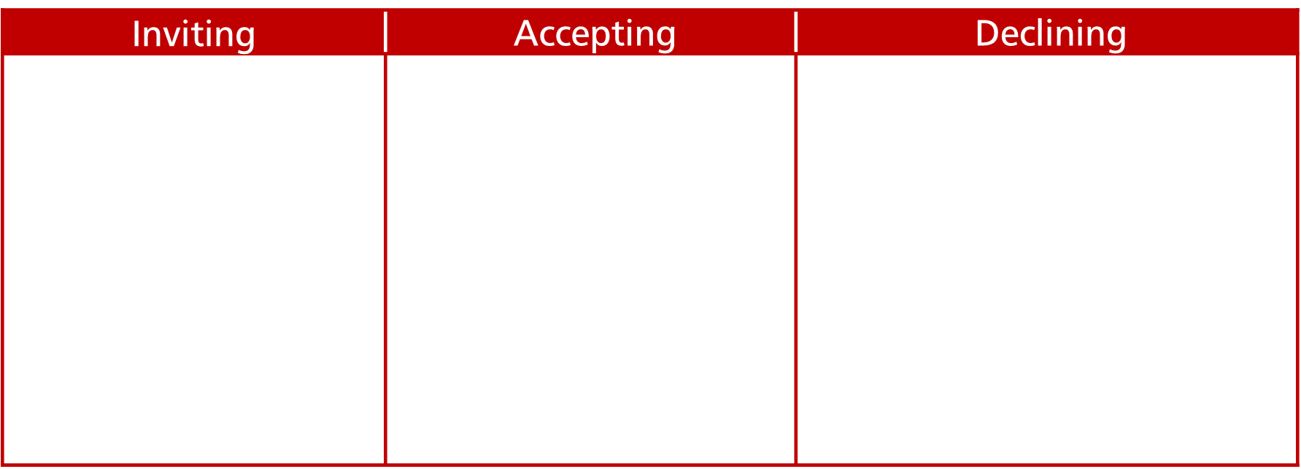
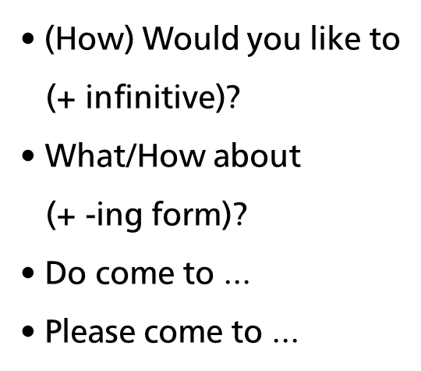
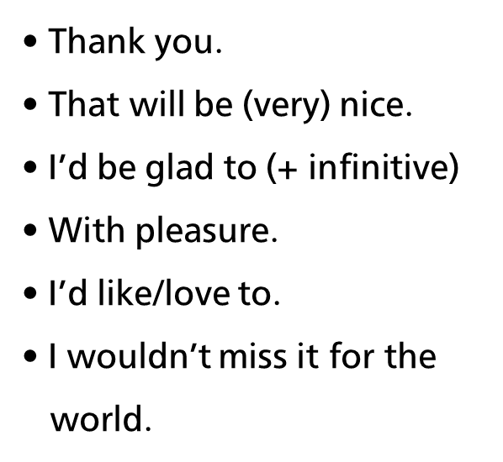
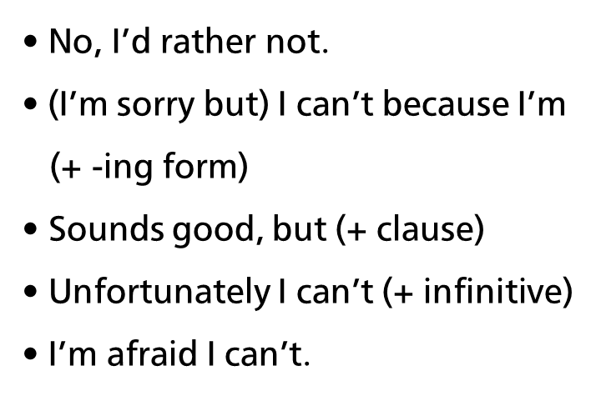

Slide 58






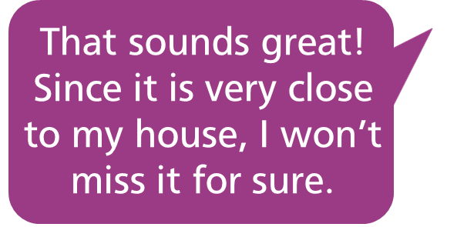
Accepting
Declining

Slide 59
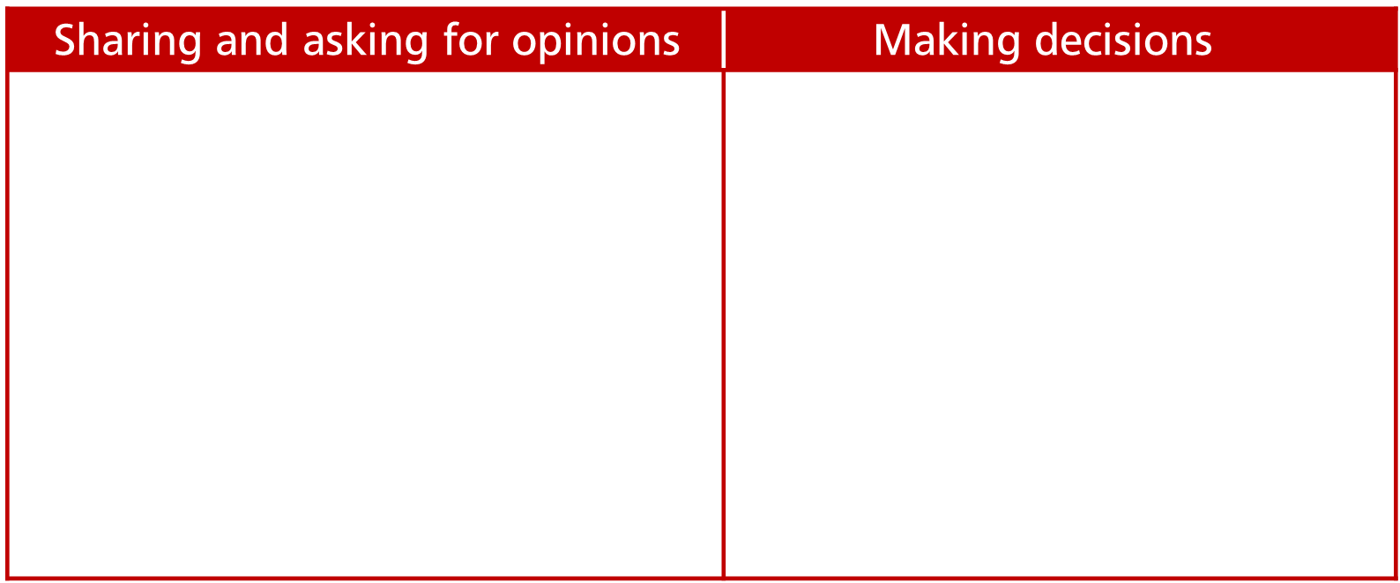
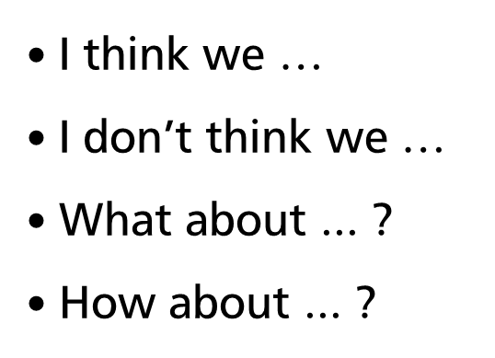


Slide 60


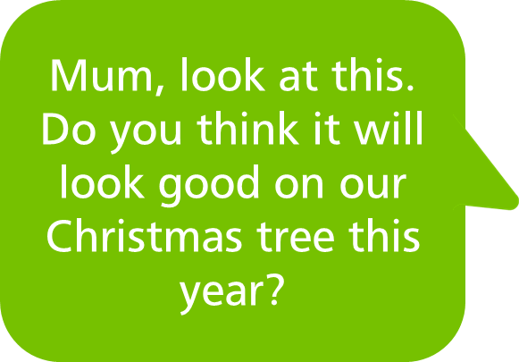


Declining

Slide 61


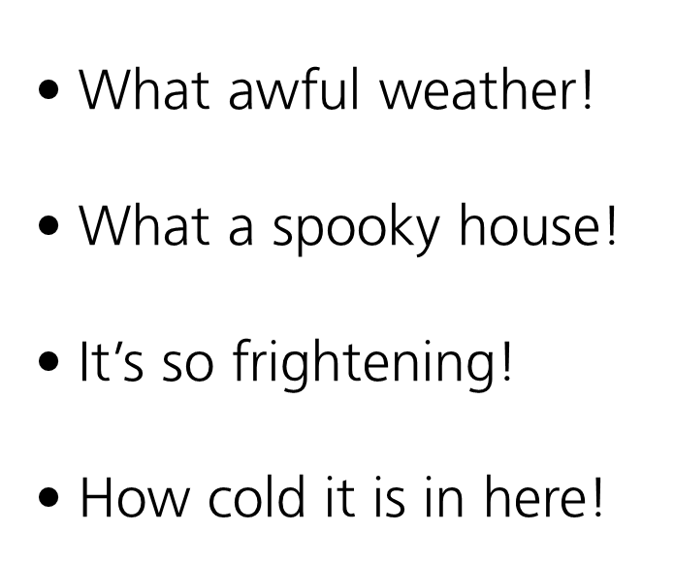


Slide 62


Slide 63
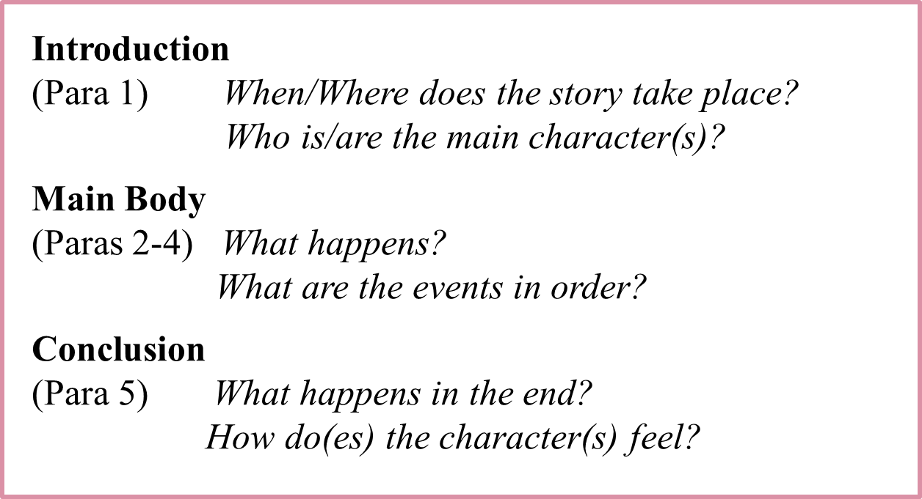

Slide 64


