Slide 1
Ordering Food

Slide 2
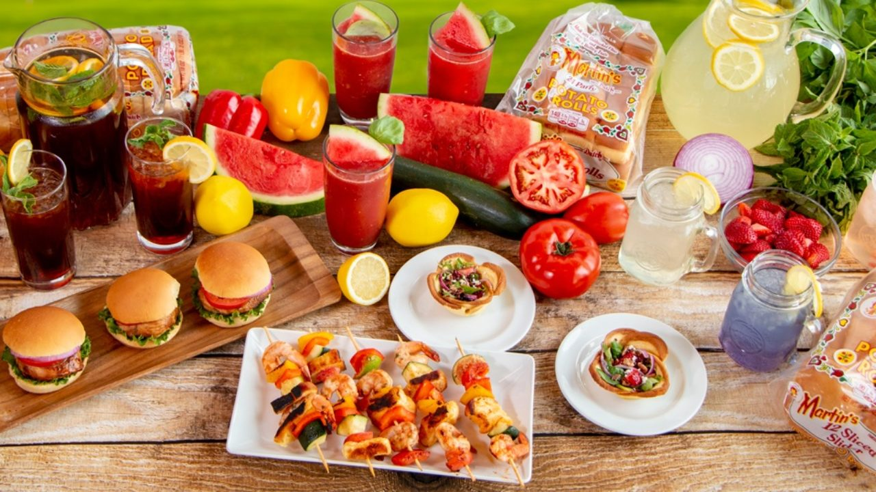

Slide 3
Vocabulary

Slide 4
Snack

Slide 5
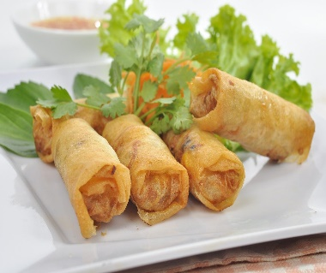
Spring rolls

Slide 6
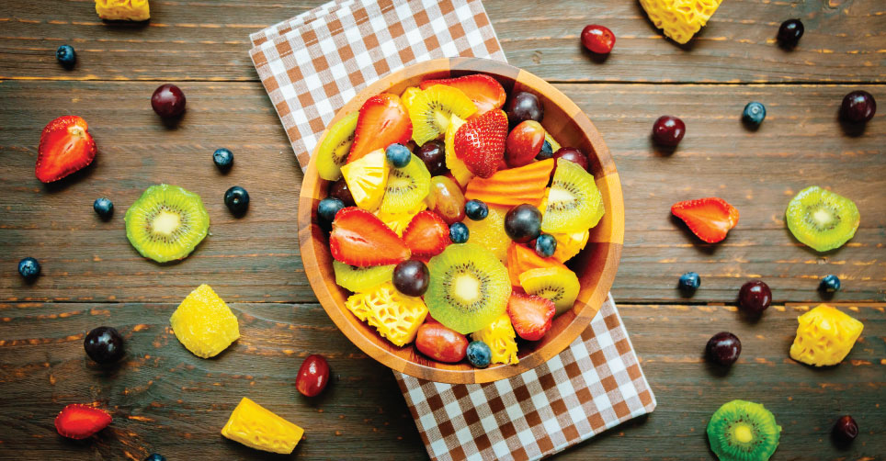
Fruit salad

Slide 7
Appetizer
is a food or drink that stimulates the appetite and is usually served before a meal.

Slide 8
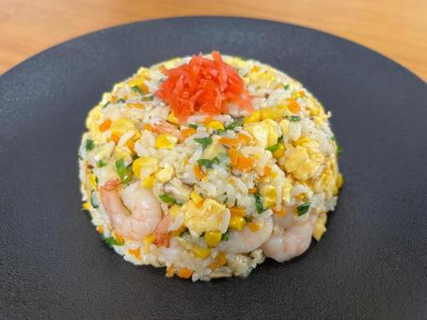
Shrimp fried rice

Slide 9
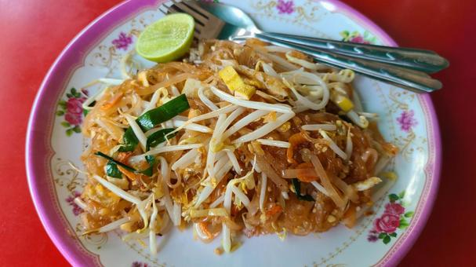
Pad Thai Noodles

Slide 10
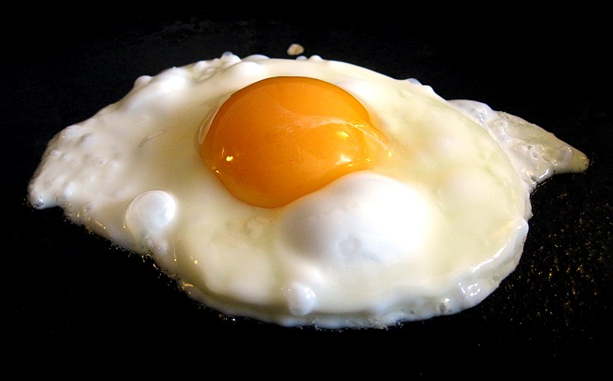
Fried egg

Slide 11
Main course
is food that is served as the main dish in a multi-course meal. It is often served after the entrée

Slide 12
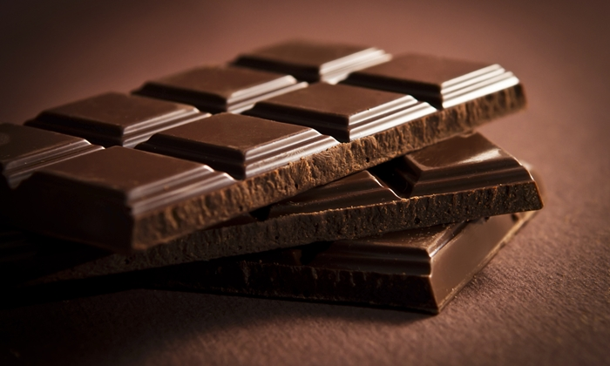
Chocolate

Slide 13
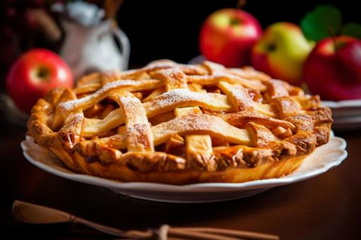
Apple pie

Slide 14
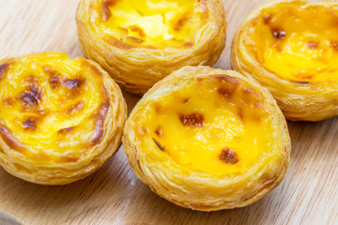
Egg tart

Slide 15
Dessert
is something sweet, such as fruit, pastry, or ice cream, that you eat at the end of a meal.

Slide 16
Ordering food Expressions

Slide 17
Expressions | Responses
How can I help you? May I help you? | I’d like to make a reservation I’d like to book a table, please. Yes, Can I have a table for 2 people, please
What would you like to drink? Can I get you a drink? May I get you anything to drink? Would you like something to drink? | I’ll have………. I’ll have a bottle of water, please
Are you ready to order? Can I take your order? What can I get for you? What would you like to have? | Yes, please I’d like to order……. I’ll have……., please Could I have…….?
Can I get the menu, please? Can I have the menu, please? | Sure. What would you recommend? What are today’s specials? What should I order?

Slide 18
Can I get you anything else? Would you like anything for dessert? | I’d like to order……. I’ll have……., please Could I have…….? No, thank you. / No, thanks.
Can I have the bill, please? I’d like to have the bill, please Bill, please. How much does it cost? | It’s …………. It’s fifty dollars That’ll be…….. That’ll be fifty dollars. It costs……..
Would you like to pay by cash or card? | I’ll pay by cash. I’ll pay by card.
Would you like a receipt? | Yes, please No, thank you. Keep the change.

Slide 19
Dialouge 1
Waiter: Hello, Can I help you?
Kim: Yes, I'd like to have some lunch.
Waiter: Would you like a starter?
Kim: Yes, I'd like a bowl of chicken soup, please.
Waiter: And what would you like for a main course?
Kim: I'd like a grilled cheese sandwich.
Waiter: Would you like anything to drink?
Kim: Yes, I'd like a glass of Coke, please.
Waiter: (After Kim has her lunch.) Can I bring you anything else?
Kim: No thank you. Just the bill.
Waiter: Certainly.
Kim: I don't have my glasses. How much is the lunch?
Waiter: That's $6.75.
Kim: Here you are. Thank you very much.
Waiter: You're welcome. Have a good day.
Kim: Thank you, the same to you.

Slide 21
Direction: Watch the video clip and answer the questions.
Where are they?
How many people are there in the restaurant?
What appetizers do they order?
What would customers like to drink?
What would customers like to have for main course?

Slide 22
Worksheet 1

Slide 23
Direction: Complete the dialogue with phrases or words.
Waiter: Hello, _________________?
Costumer: Yes, I'd like to have some dinner.
Waiter: Would you like a__________?
Costumer: Yes, I’d like a vegetable soup, please.
Waiter: And what _____________ for a main course?
Costumer: I’d like the grilled fish.
Waiter: Would you like _____________?
Costumer: Yes, I'd like a glass of orange juice, please.
Waiter: Can I bring you ___________?
Costumer: __________. Just the bill.
Waiter: Ok sir. I’ll be right back with the bill.

Slide 24
Worksheet 2

Slide 25
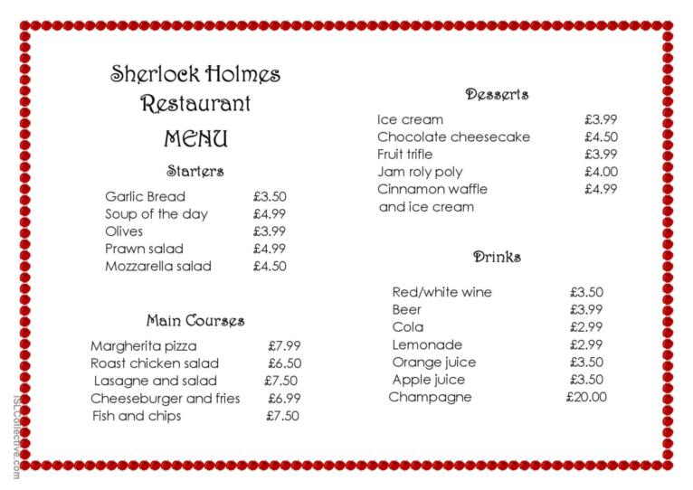
Direction: Look at the menu and write the conversation.

Slide 26
Task
Divide into groups of 4-5 people to compose a conversation about ordering food and drinks in a restaurant.
…………………………………………………………………………………………………………………………………………………………………………………………………………………………………………………………………………………………………………………………………………………………………………………………………………………………………………………………………………………………………………………………………………………………………………………………………………………………………………………………………………………………………………………………………………………………………………………………………………………………………………………………………………………………………………………………………………………………………………………………………………………………………………………………………………………………………………………………………………………………
Name ………………………………………………
Name ………………………………………………
Name ……………………………………...........
Name ……………………………………………..
Name ……………………………………………..
Class …………………………………………......

