Slide 1
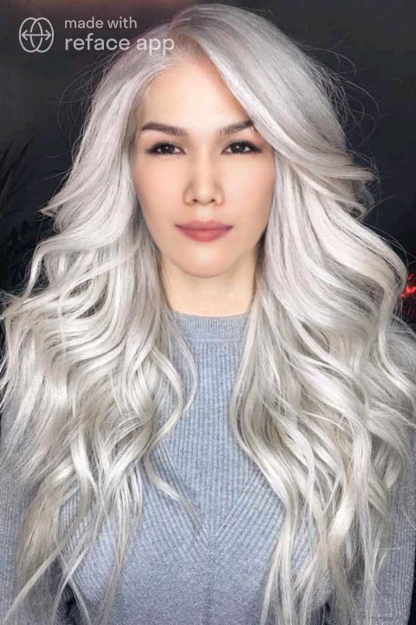

Slide 4
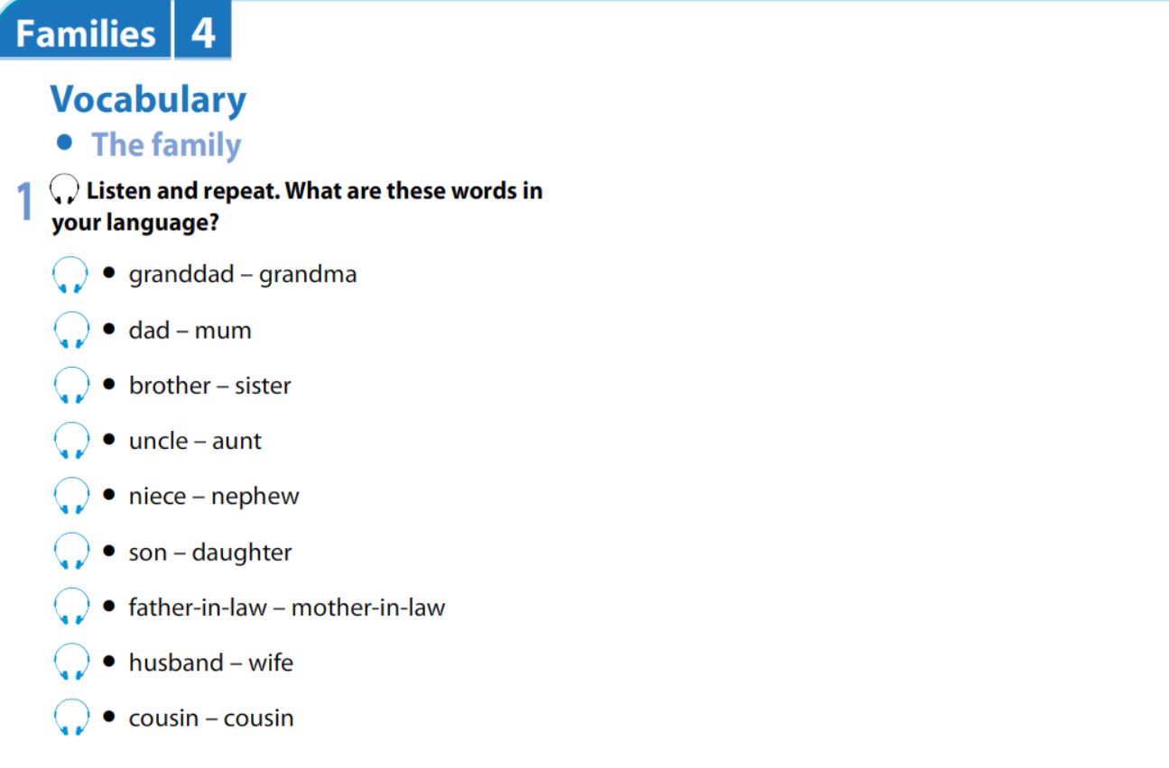

Slide 5
cousin
her cousin
son
their son
grandma
her grandma
aunt
her aunt
nephew
his nephew
mum
their mum
father-in-law
his father-in-law

Slide 7
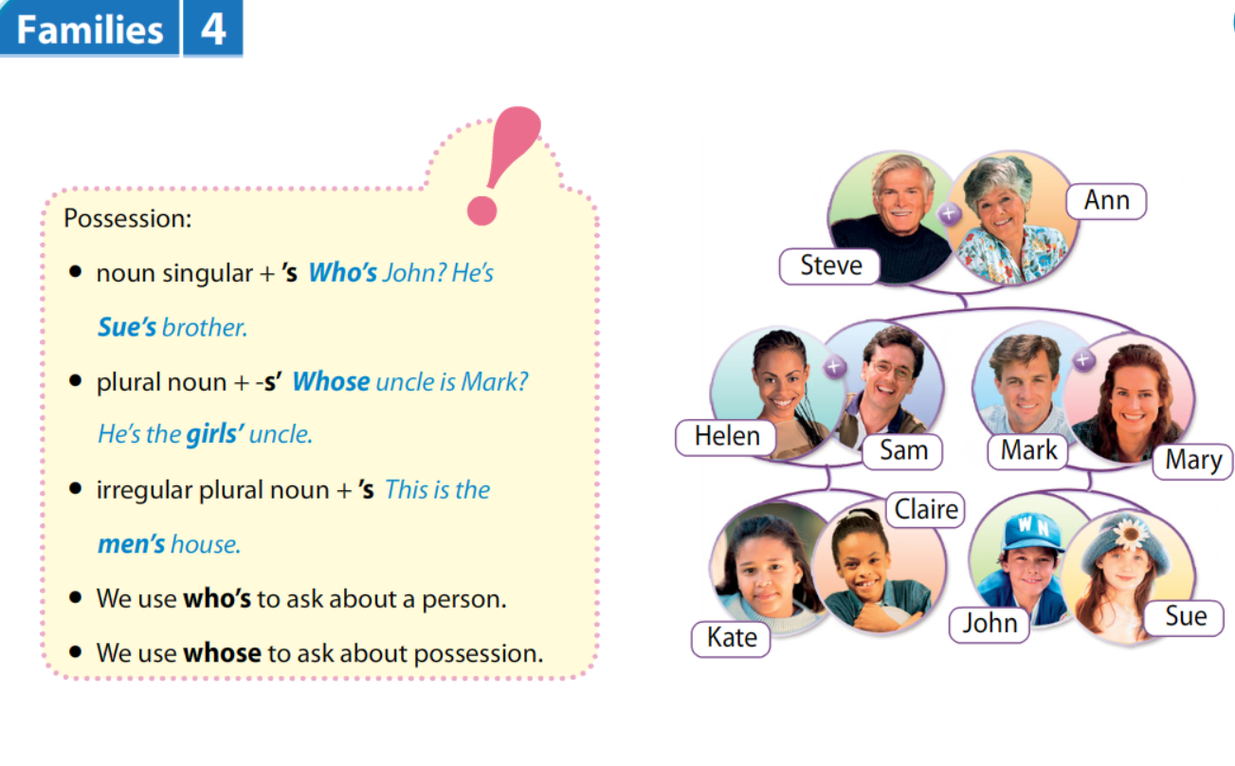

Slide 18
Answer the questions

Slide 20
Betty Rubble

Slide 22
Answer the questions

Slide 23
There are 4 members.
Pebbles’ hobby is baseball.
Fred’s favorite sports are bowling and golf.
Dino is Pebbles’ pet.
Barney and Betty Rubble’s son.
She is serious and modern.
Wilma’s best friend is Betty Rubble.
He can play the piano and drums.

Slide 25
Monday 9th September 2024
Read the text and answer the questions.

Slide 26
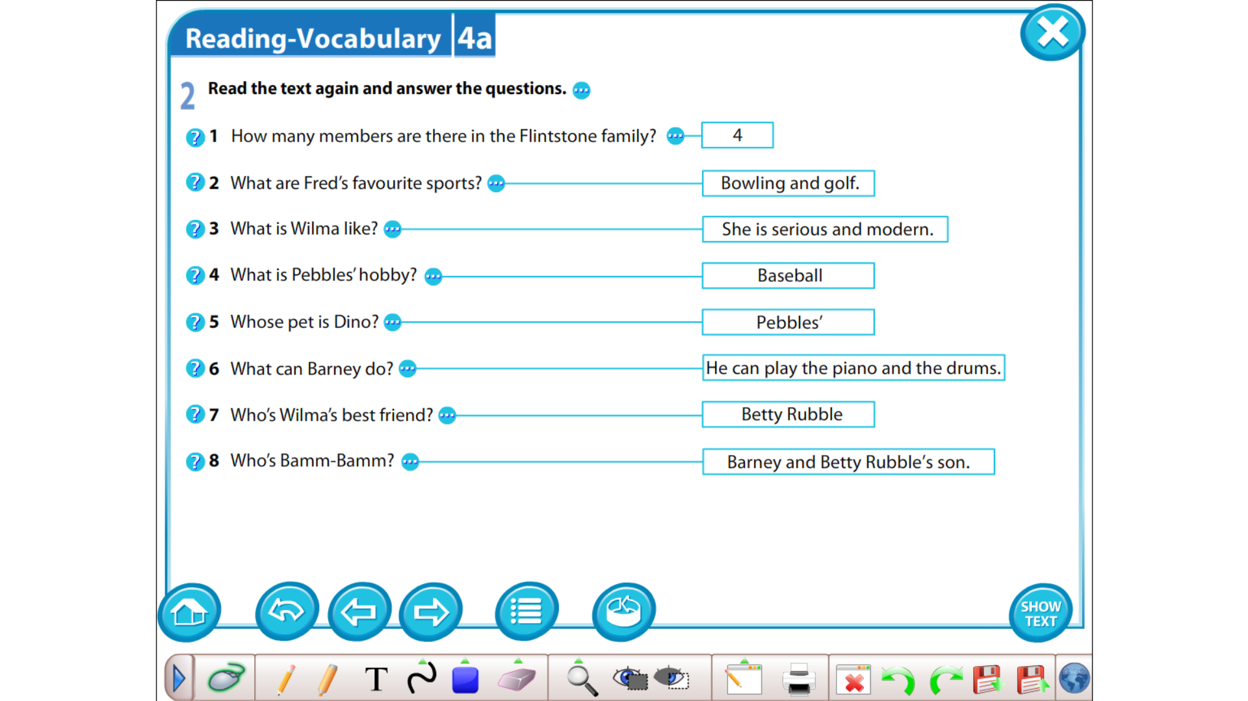

Slide 27
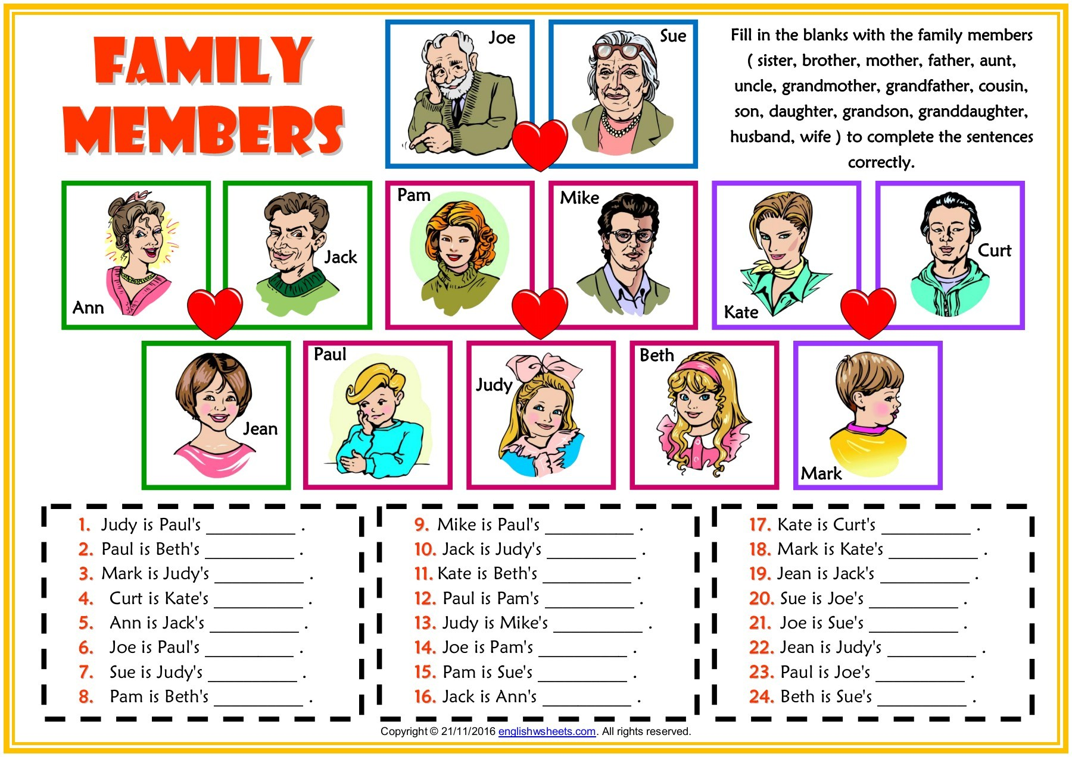
Monday 6th September 2021
Copy 1-24 in your notebook and fill in the blanks with the family members.

Slide 29
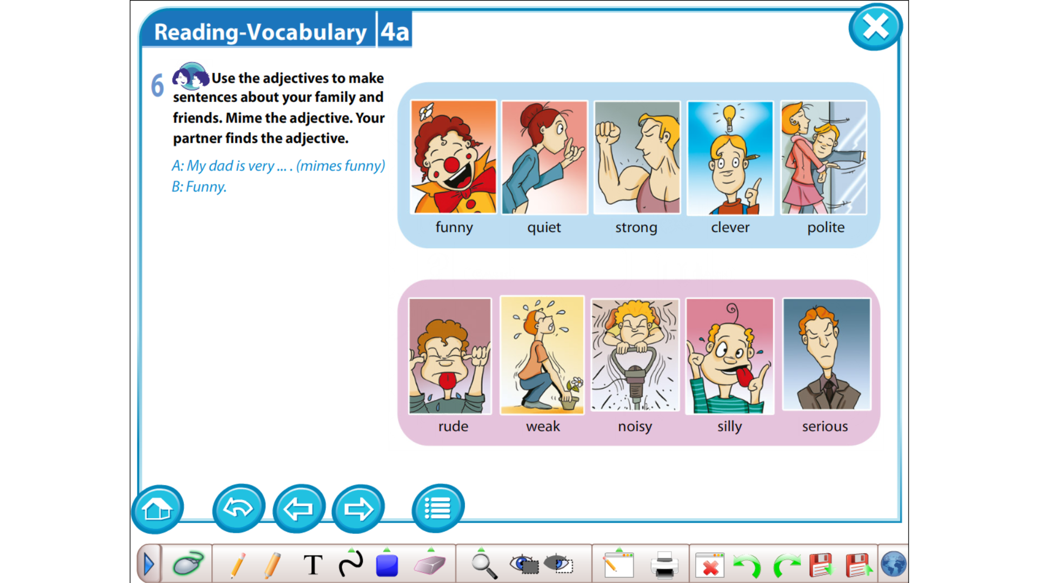

Slide 30
