Slide 1
Gerund or infinitive
swimming
Debbie likes __________ (swim).

Slide 2
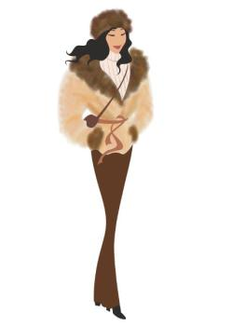
Gerund or infinitive
to buy
Janet wants __________ (buy) a new coat.

Slide 3
Gerund or infinitive
I’m quite sure they’ll decide _____(go) to England soon.
to go

Slide 4
Gerund or infinitive
I absolutely love _________ (speak) English.
speaking

Slide 5
Gerund or infinitive
smoking
I gave up _________ (smoke) some time ago.

Slide 6
Gerund or infinitive
At the water distributor I stopped ________ (talk) to Barbara.
to talk

Slide 7
Gerund or infinitive
I’d hate ________ (be) a nurse. I can’t stand blood.
to be

Slide 8
Gerund or infinitive
I’m trying ________ (work).
Please stop __________ (talk)!
to work
talking

Slide 9
Gerund or infinitive
I’m tired. I want ________ (go) to bed.
to go

Slide 10
Gerund or infinitive
running
The buses usually stop _________ (run) before midnight.

Slide 11
Gerund or infinitive
being
We must avoid _______ (be) late for the meeting.

Slide 12
Gerund or infinitive
I’d like __________ (visit) Texas one of these days.
to visit

Slide 13
Gerund or infinitive
Don’t forget __________ (send) me a postcard!
to send

Slide 14
Gerund or infinitive
Goodbye. I hope _________ (see) you again soon.
to see

Slide 15

Gerund or infinitive
Sometimes a country refuses _______ (take) part in the Olympics.
to take

Slide 16
Gerund or infinitive
to help
I’ve agreed _________ (help) organize the trip.

Slide 17
Gerund or infinitive
I really regret _________ (sell) my boat.
selling

Slide 18
Gerund or infinitive
I’m taking the dog out. Would you like ________ (come)?
to come

Slide 19
Gerund or infinitive
to leave
I hear you’re preparing _________ (leave) the company.

Slide 20
Gerund or infinitive
My decision proved _______ (be) the best thing for everyone.
to be

