Slide 1
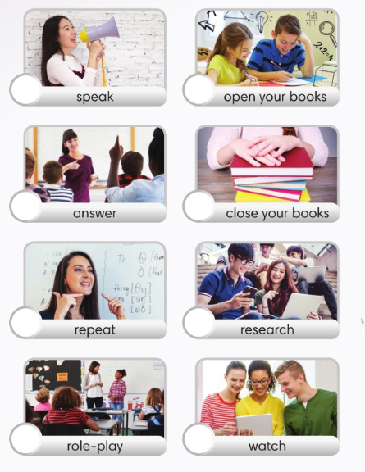
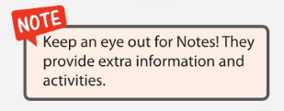
1
14
7
4
6
2
10
12
3
11
5
8
9
13

Slide 2
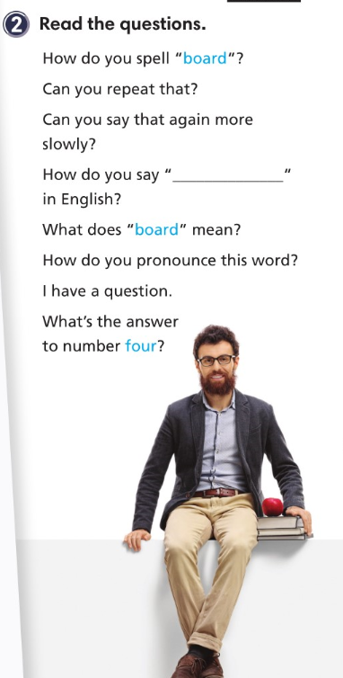

Slide 4
8
3
1
2
6
5
7
4

Slide 5
strength
institution
capable
behalf
association
award
competitive
weakness

Slide 9
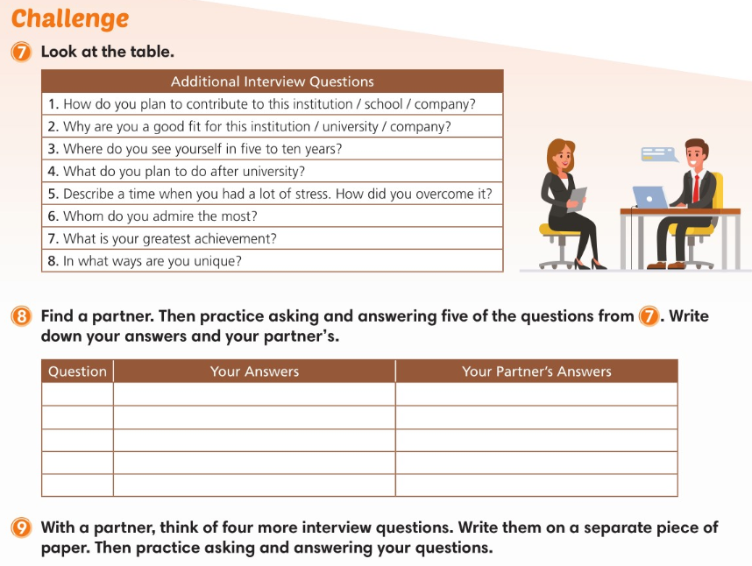

Slide 10
sufficient
commit
assume
respond
intention
circumstance
tough
cope

Slide 11
tough
intention
cope
commit
sufficient

Slide 12
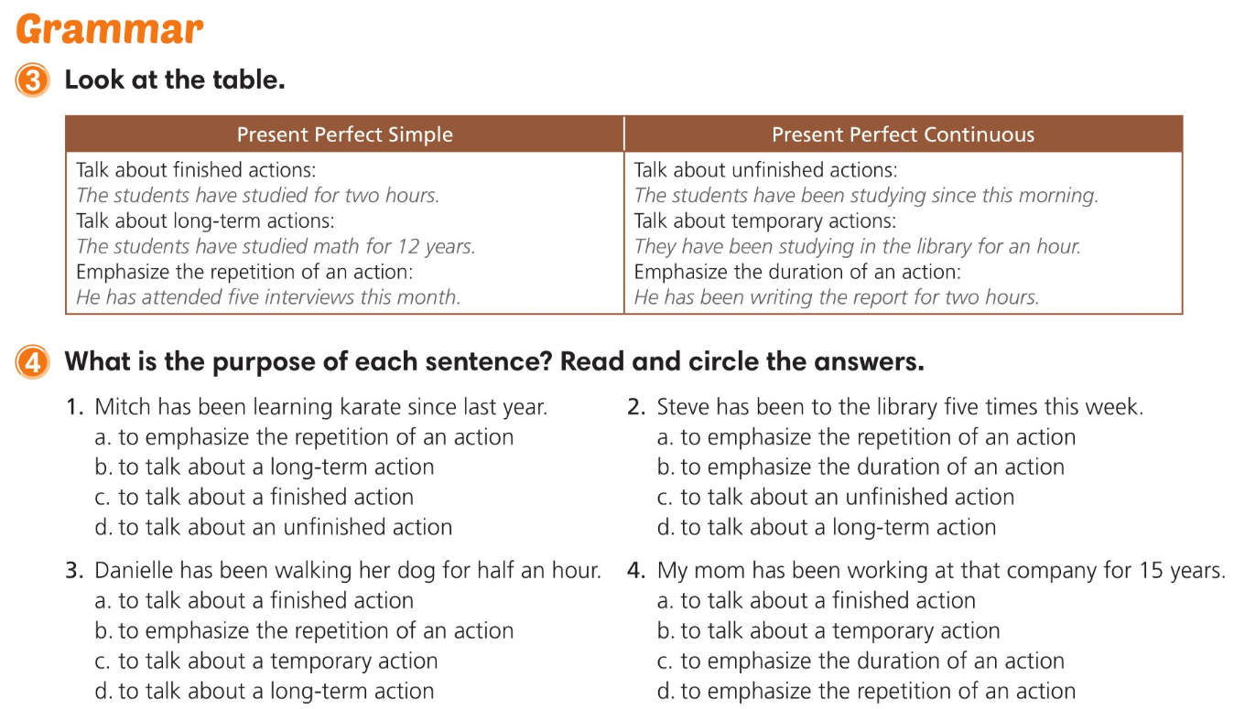

Slide 13
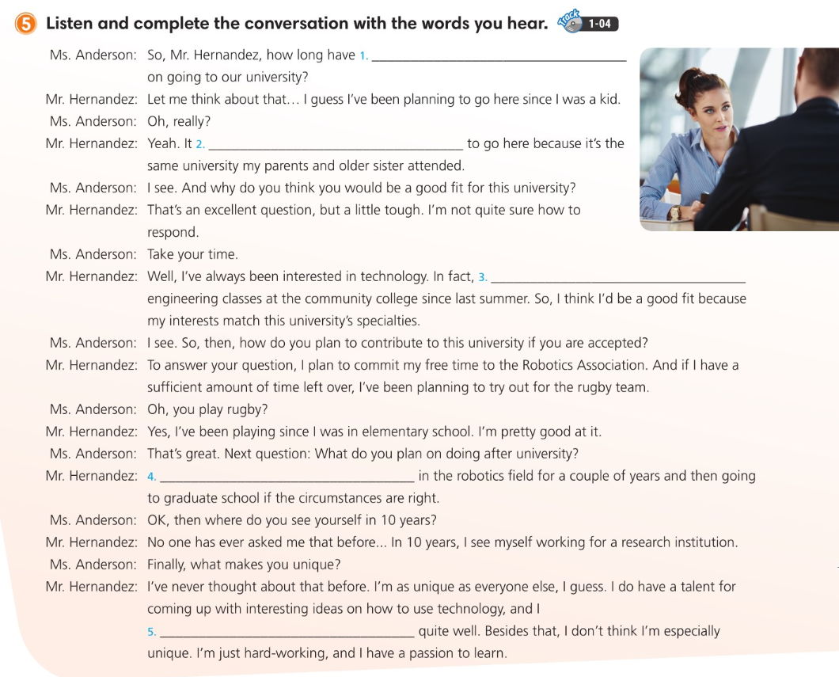
you been planning
has always been my intention
I’ve been attending robotics
I’ve been thinking of working
cope with stress and deadlines

Slide 14
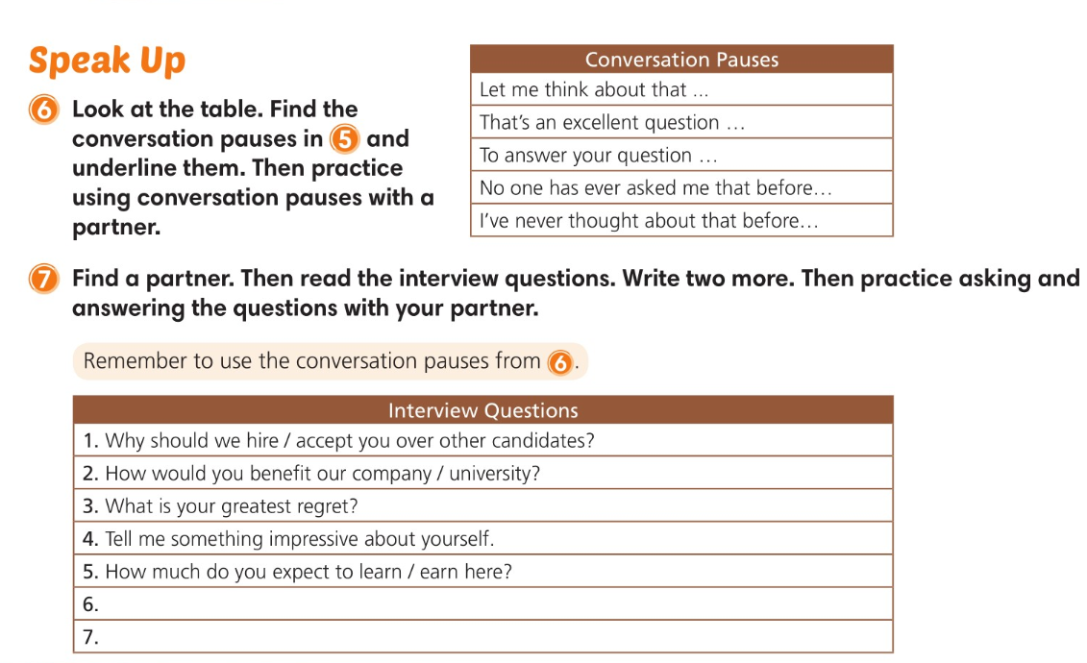

Slide 15
1
3
2
4
8
6
7
5

Slide 20
2
4
7
3
5
1
8
6

Slide 21
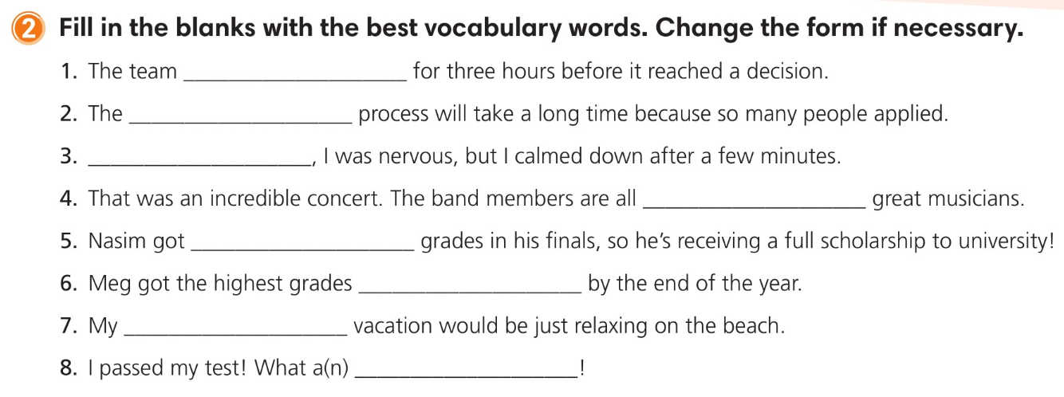
deliberated
selection
Initially
truly
outstanding
overall
ideal
relief

Slide 23
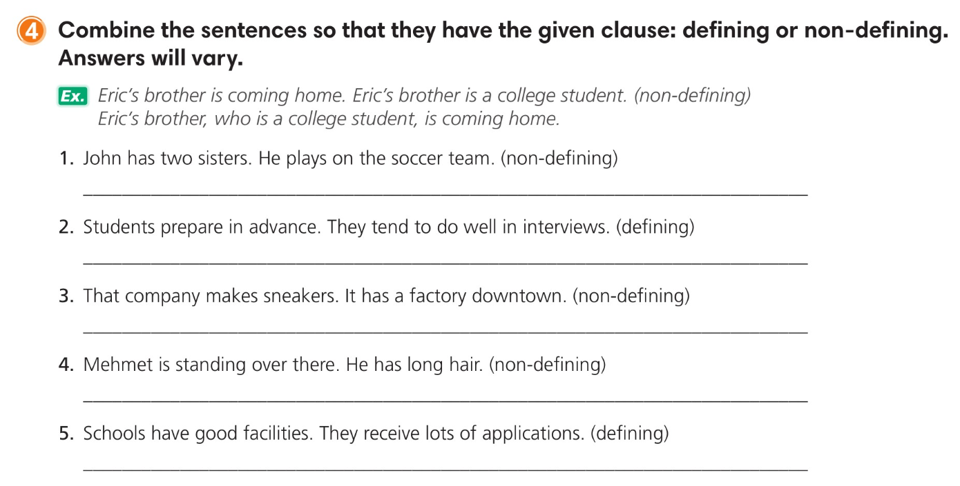
John, who has two sisters, plays on the soccer team. / John, who plays on the soccer team, has two sisters.
Students who prepare in advance tend to do well in interviews.
That company, which has a factory downtown, makes sneakers. / That company, which makes sneakers, has a factory downtown.
Mehmet, who has long hair, is standing over there.
Schools which have good facilities receive lots of applications.

Slide 24
that
outstanding
initially
which
Overall
who
deliberating
selection

Slide 26
2
3
1

Slide 27
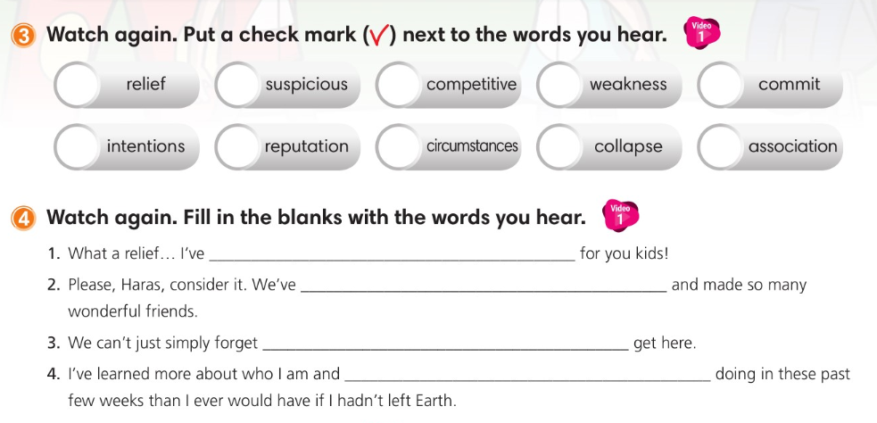
been looking everywhere
seen so much
the people who helped us
what I am capable of

Slide 29
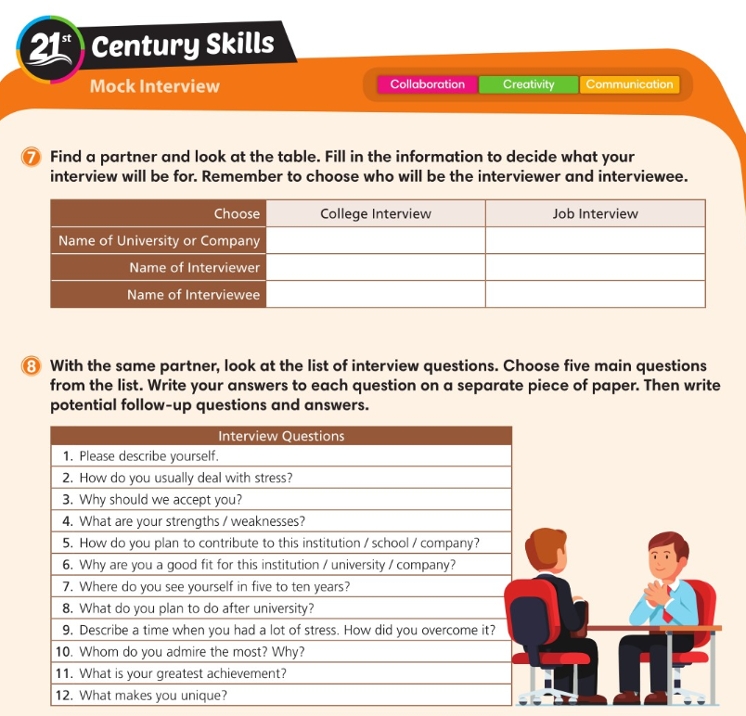

Slide 30
