Slide 1
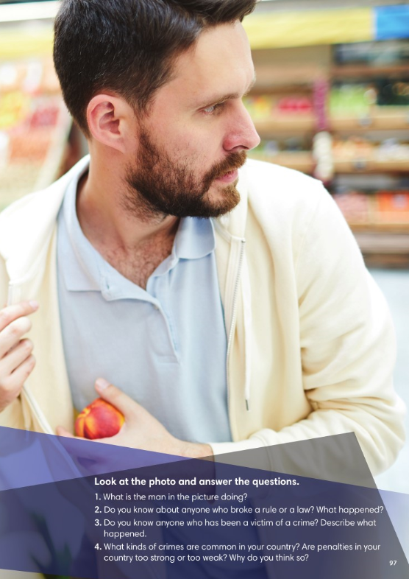

Slide 2
3
6
8
4
7
5
2
1

Slide 3
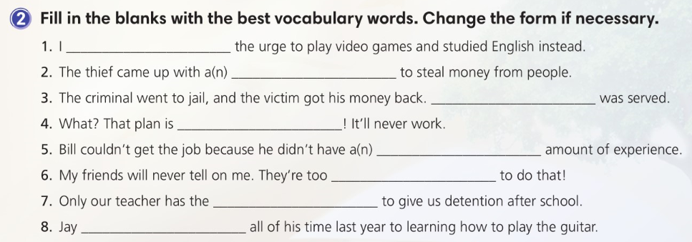
resisted
scheme
Justice
nonsense
adequate
loyal
authority
devoted

Slide 7
2
8
3
5
6
4
7
1

Slide 8
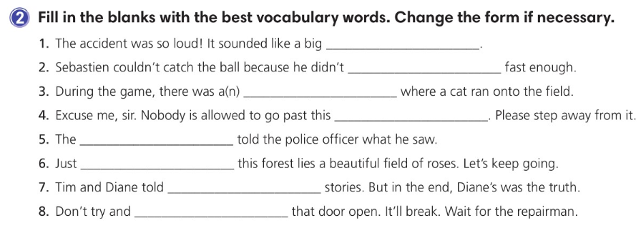
explosion
react
incident
barrier
witness
beyond
contrasting
force

Slide 11
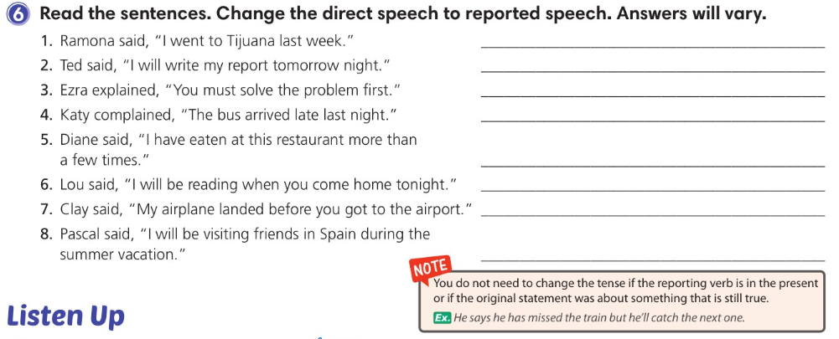
Ramona told me (that) she had gone to Tijuana the week before.
Ted said (that) he would write his report the following night.
Ezra explained (that) I must/had to solve the problem first.
Katy complained (that) the bus had arrived late the night before.
Diane told me (that) she had eaten at that restaurant more than a few times.
Lou told me (that) he would be reading when I came home that night.
Clay said (that) his airplane had landed before I had gotten
to the airport.
Pascal said (that) he would be visiting friends in Spain during
the summer vacation.

Slide 13
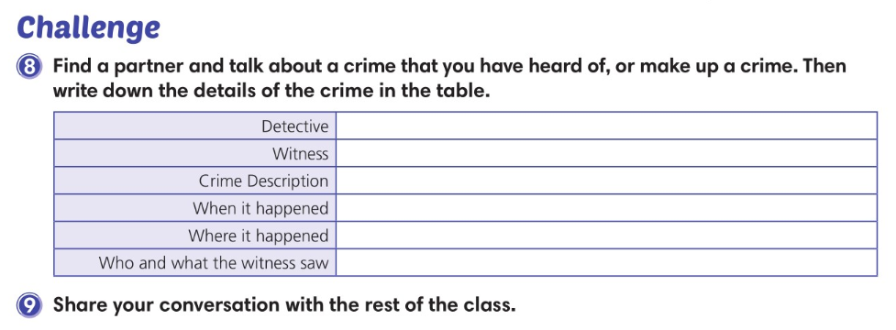

Slide 14
recall
cheat
hesitate
accuse
threaten
immoral
assure
conflict

Slide 16
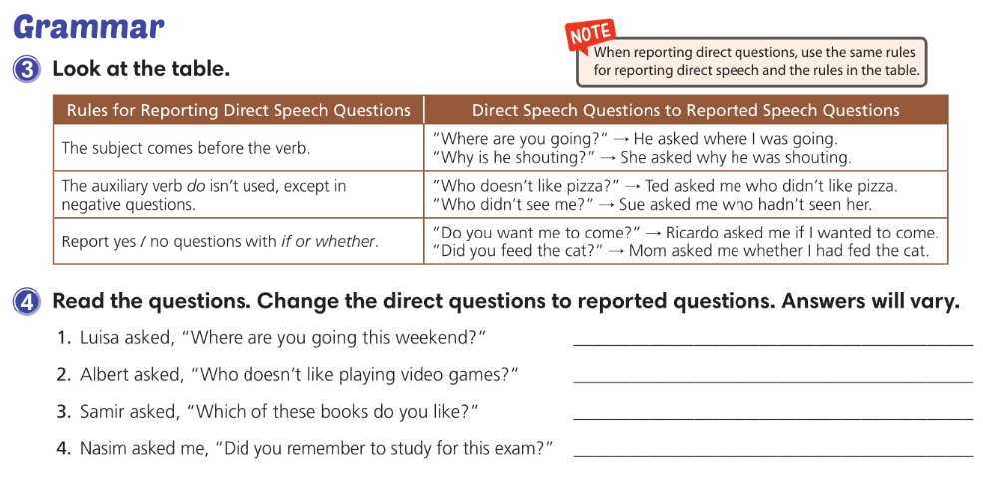
Luisa asked me where I was going that weekend.
Albert asked me who didn’t like playing video games.
Samir asked me which of those books I liked.
Nasim asked me if/whether I remembered to
study for that exam.

Slide 17
asked her if everything
was pretty far away
cheating on his final exam
she had already accused
assured her
threatened to tell
asked Jess if it could have
hesitated for a

Slide 18
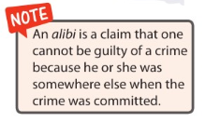

Slide 20
investigate
suspect
relevant
bad-tempered
observe
launch
swear
version

Slide 22
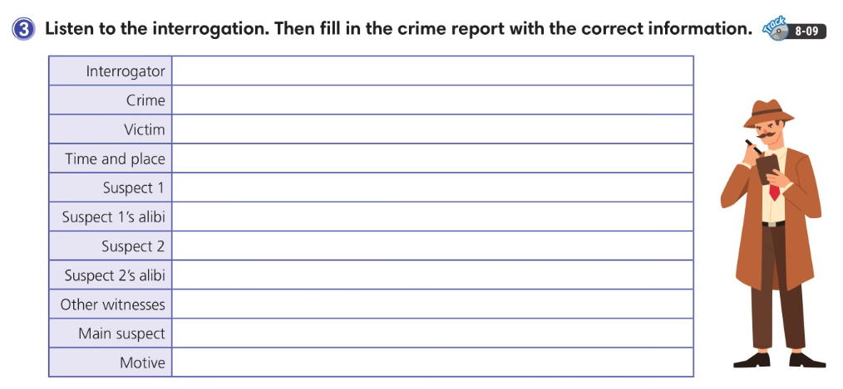
Mrs. Phillips
Purse stolen
Sunny
Classroom in the morning
Skyler
Was in the restroom. Sunny saw him come back.
Eddie
Doctor’s appointment
Coach Carter
Eddie
Buy a new pair of basketball shoes

Slide 26
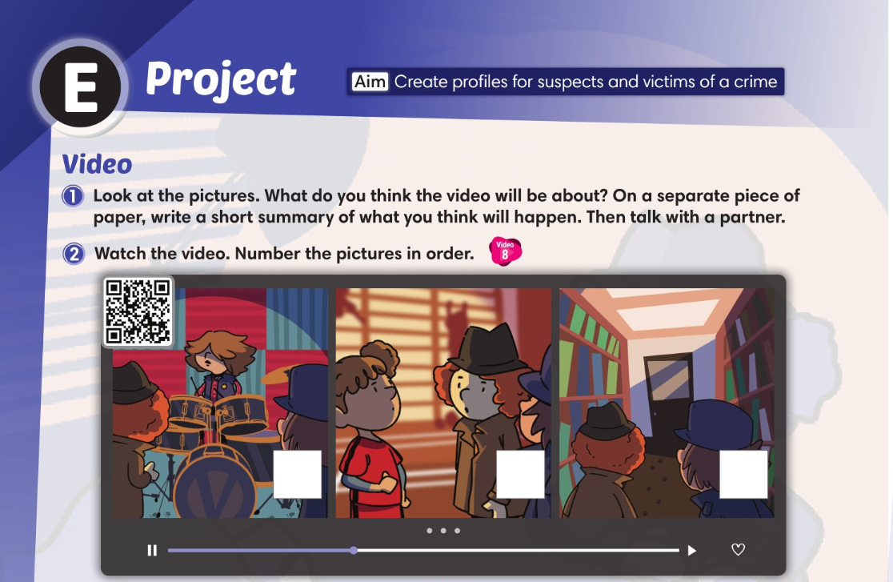
1
2
3

Slide 27
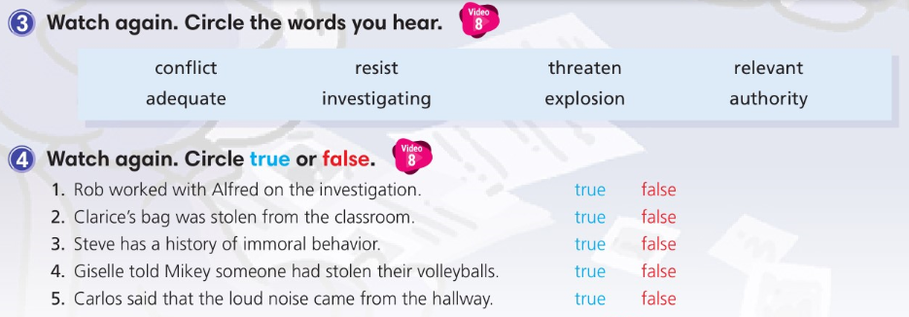

Slide 28
finished investigating
we talked
was thirsty
went
whether they knew
had committed
asked us if we
relevant

Slide 29
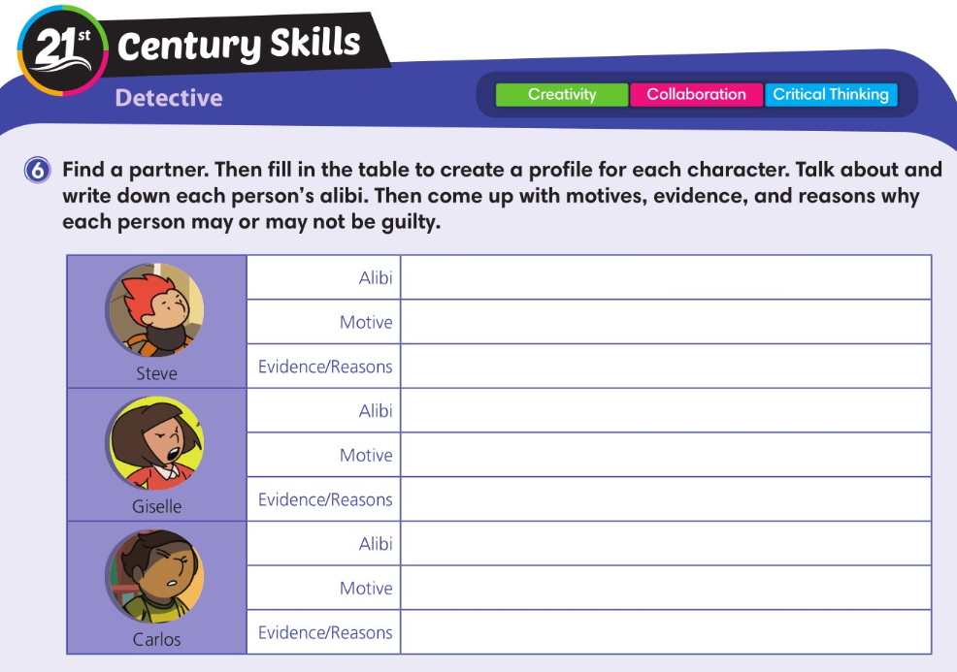

Slide 30
